Slide 1
CASE STUDY - Time Series Forecasting Sales and Quantity for a Superstore Giant
Group Name:
Sivaiah Aelasrolu
Hariharan Subramaniam
Thripthi Raj
Abhishek Pandey

Slide 2
Business understanding:
“Global Mart” is an online store super giant having worldwide operations. It takes orders and delivers across the globe and deals with all the major product categories - consumer, corporate & home office.
The store caters to 7 different market segments and in 3 major categories.so there are 21 segments of business.
Objective:
To forecast the sales and the demand for the next 6 months, that would help theatre manager to manage the revenue and inventory accordingly.
Scope of this case study:
Find out 2 most profitable (and consistent) segment from the 21 segments of business and forecast the sales and demand for these segments.

Slide 3
Problem solving methodology
There are 24 attributes for each transaction
There are 7 geographical market sectors -APAC,EU,EMEA,LATAM,AFRICA,CANADA and US
There are 3 segments that customer belong to - Consumer ,Corporate and Home Office
Create 21 subsets based on the market and the customer segment level.
convert the transaction-level data into a time series.
aggregate the 3 attributes - Sales, Quantity & Profit, over the Order Date to arrive at monthly values for these attributes
Find the 2 most profitable and consistently profitable segments using coefficient of variation.
Data Understanding
Data Preparation
Smoothen the data
Use classical decomposition and auto ARIMA for forecasting
Forecast the sales and quantity for the next 6 months for the 2 most profitable segments
Model Building
Test the accuracy of the forecast the separated out last 6 months values from the dataset
Check the 6 months forecast using the out-of-sample figures.
Use MAPE as a means to evaluate the model
Model Evaluation

Slide 4
EDA
EDA
Attribute | Details
Dimensions | No of Row=51290 No of col=24
NAs | Postal.Code column has 41296 NAs.Other columns do not have NAs
Blank Values | None in the dataset
Column Name | Observations/Changes
Order.DAte,Ship.Date | Changed to date format
Segment,Market Segment | Both are combined to derive 21 subsets

Slide 5
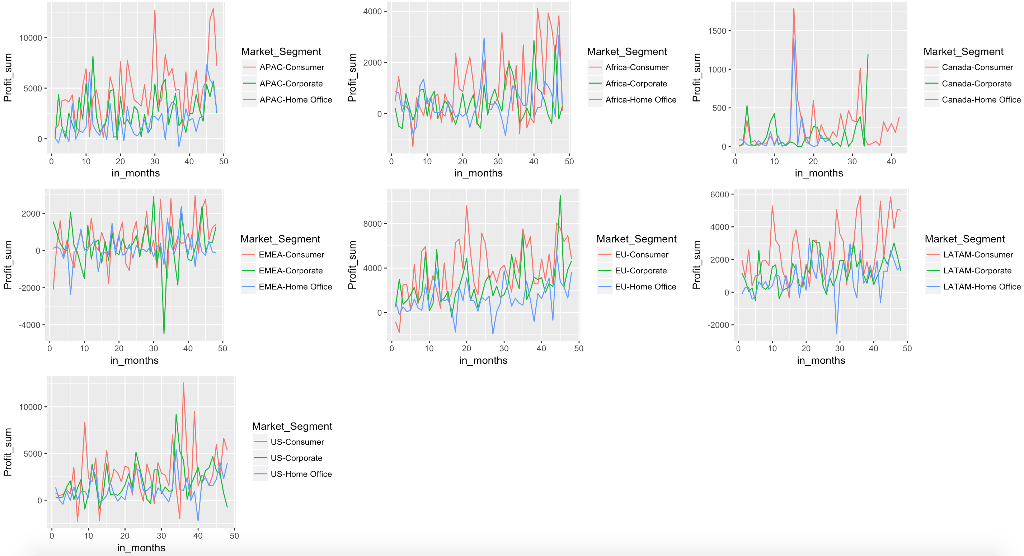
EDA - Plotting profits across segments

Slide 6
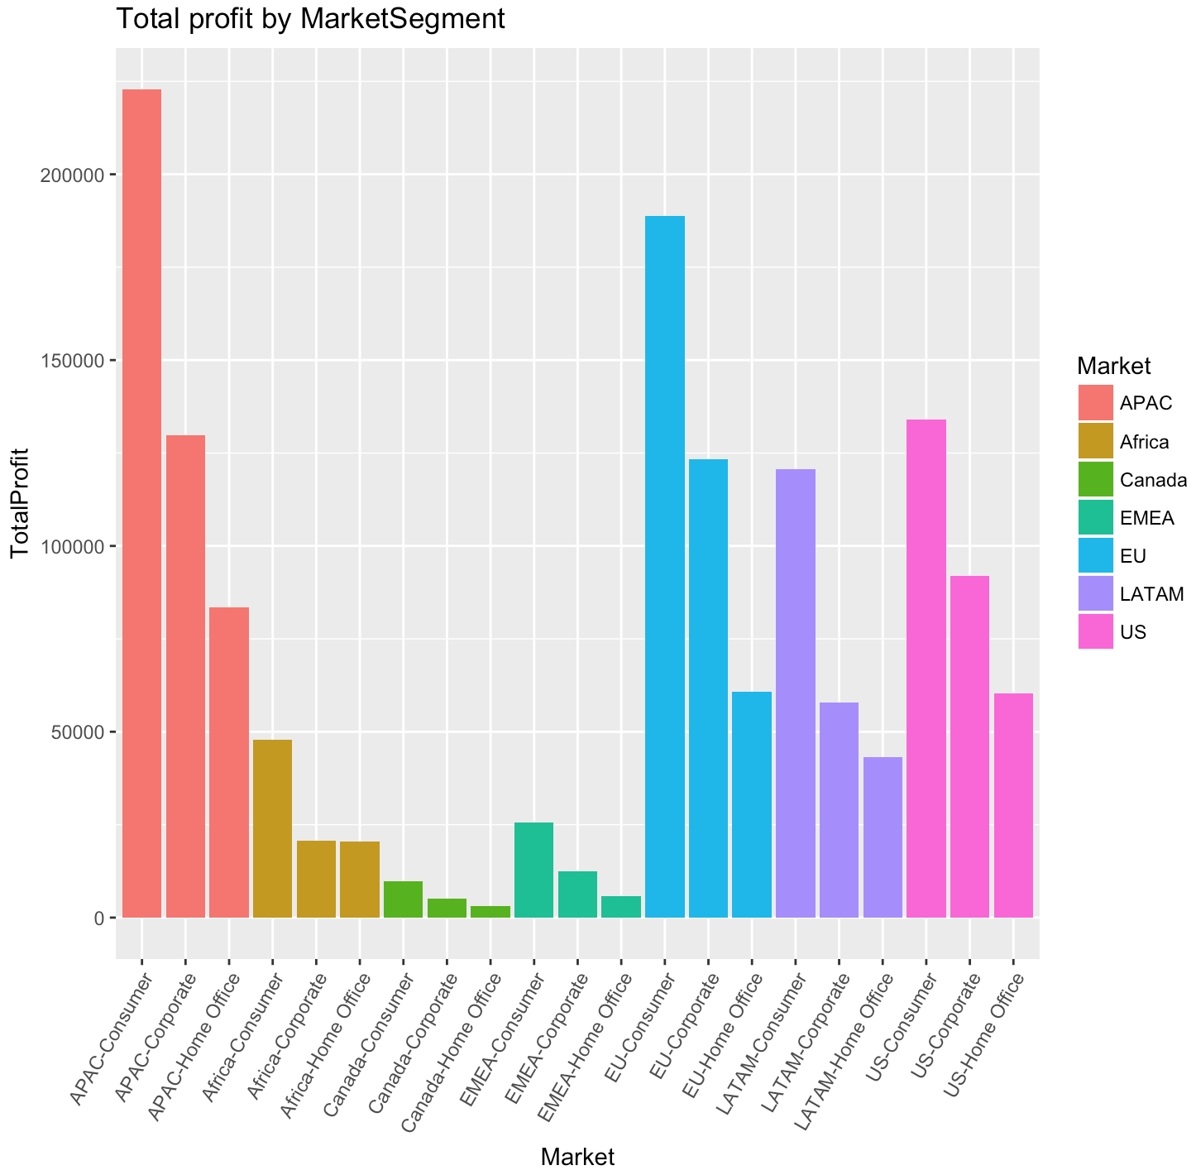

Slide 7
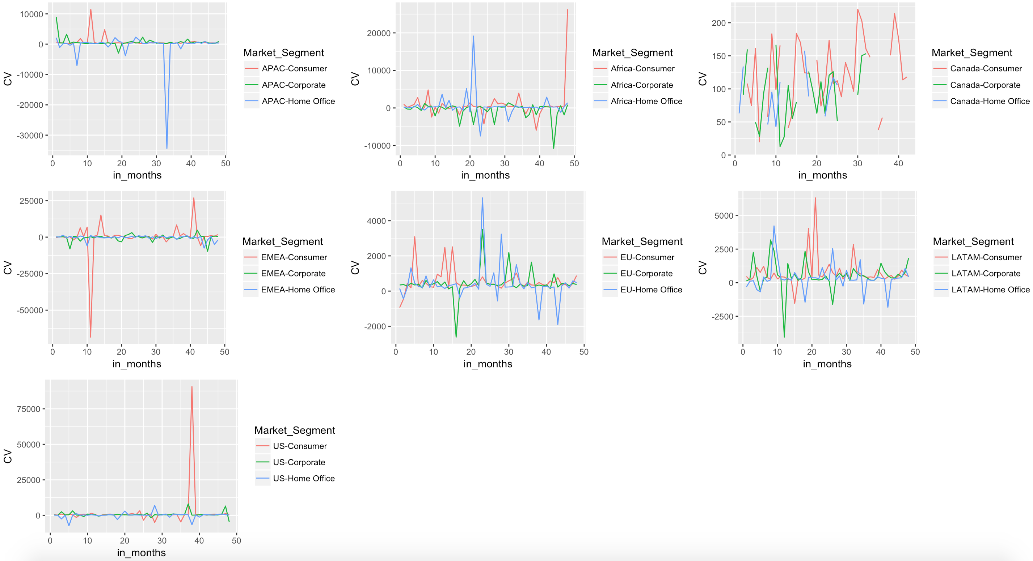
EDA - Plotting ‘Coefficient of Variation’ across segments

Slide 8
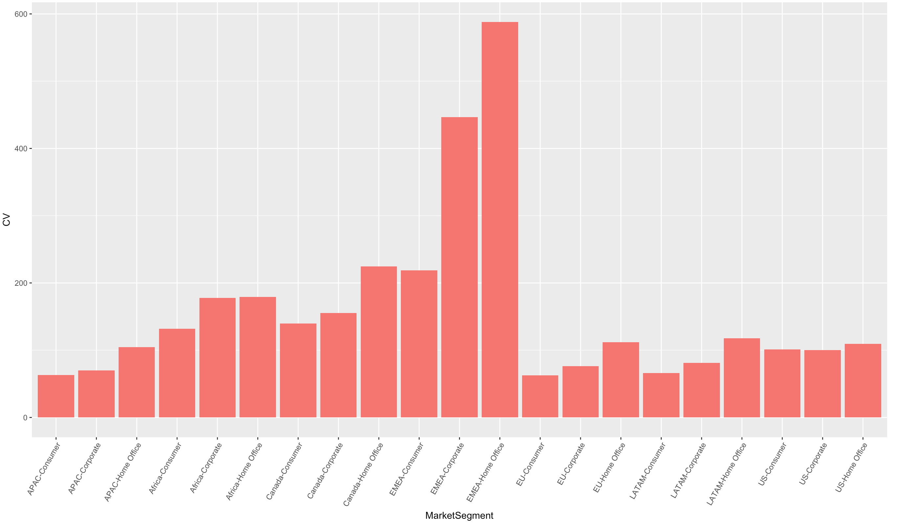
Coefficient of Variation

Slide 9
Two Profitable(Consistently profitable segments)
Based on analysis, following two segments are selected as 2 profitable(consistently profitable) segments,
1.APAC-Consumer
2..EU-Consumer

Slide 10
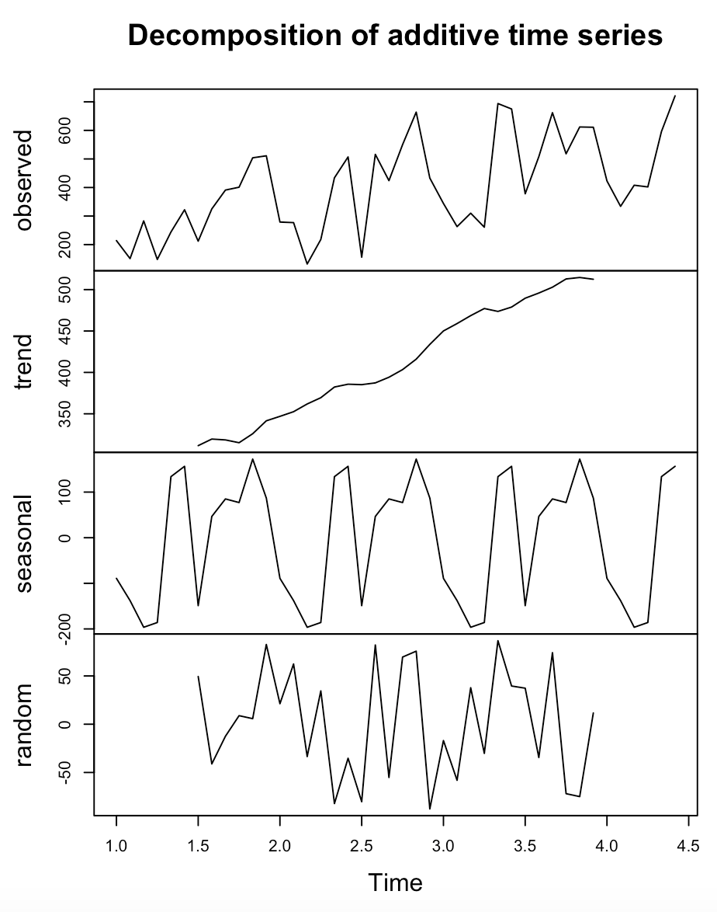
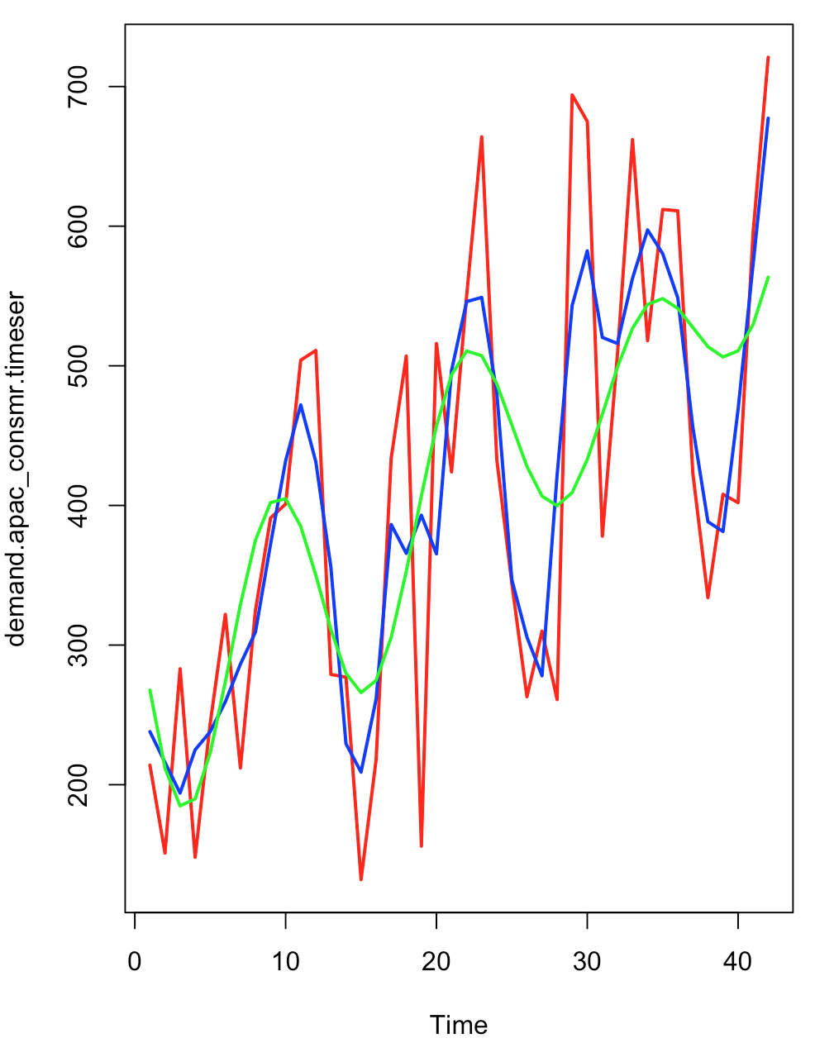
Model Building - Demand(Quantity) for APAC-Consumer
Classical Decomposition Method
Classical Decomposition Method
It is Evident from the decomposition that the Demand:
[1] A linearly increasing trend with a positive slope
[2] A low amplitude sinusoidal seasonality ranging between -180 to +150 units.
[3] The Demand Time Series will be and Additive Forecasting Model
Model Building
In the graph ,
[1]The red line indicates the original time series of APAC-Quantity .
[2]The Blue line indicates the smoothed line using moving average function.
[3]The green line is the linear model built using the function Sin,Cosine and Poly function of degree 1.
Accuracy of the global prediction
ME RMSE MAE MPE MAPE
Test set 2.070734e-13 68.5008 54.3401 -2.730737 14.15424

Slide 11
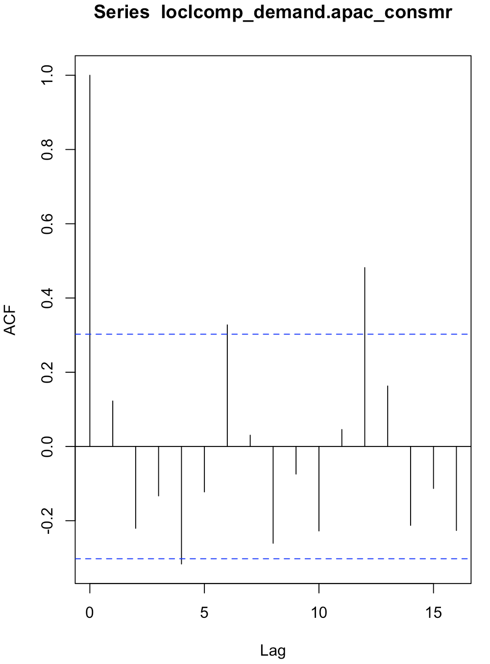
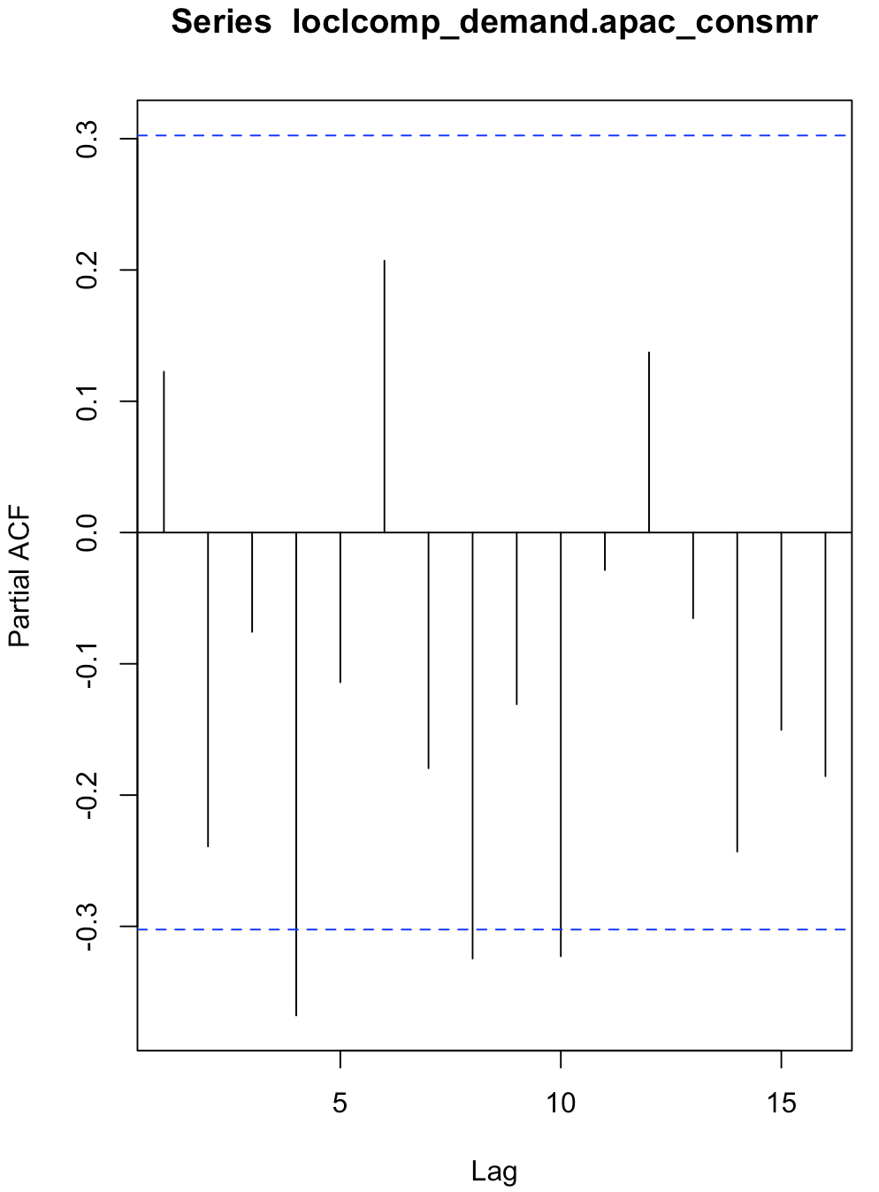
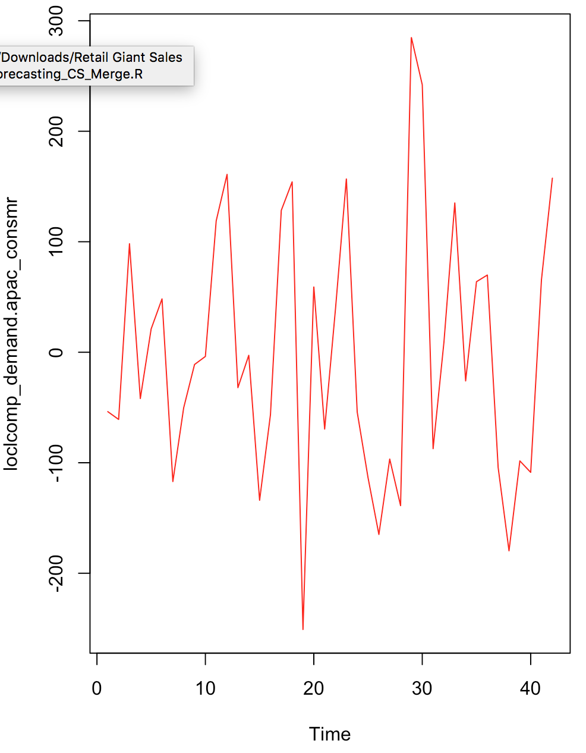
Model Building - Demand(Quantity) for APAC-Consumer (Cont 1..)
Classical Decomposition Method
The first graph is a visual of the local component that was derived after removing global trend from the original time series.
The ACF and PACF plot indicate that the local component is a weakly stationary series.
Further modelling the local component with ARIMA gives ARIMA(0,0,0) with zero mean ; This implies that there is no AR(p) or MA(q) series in the local component.

Slide 12
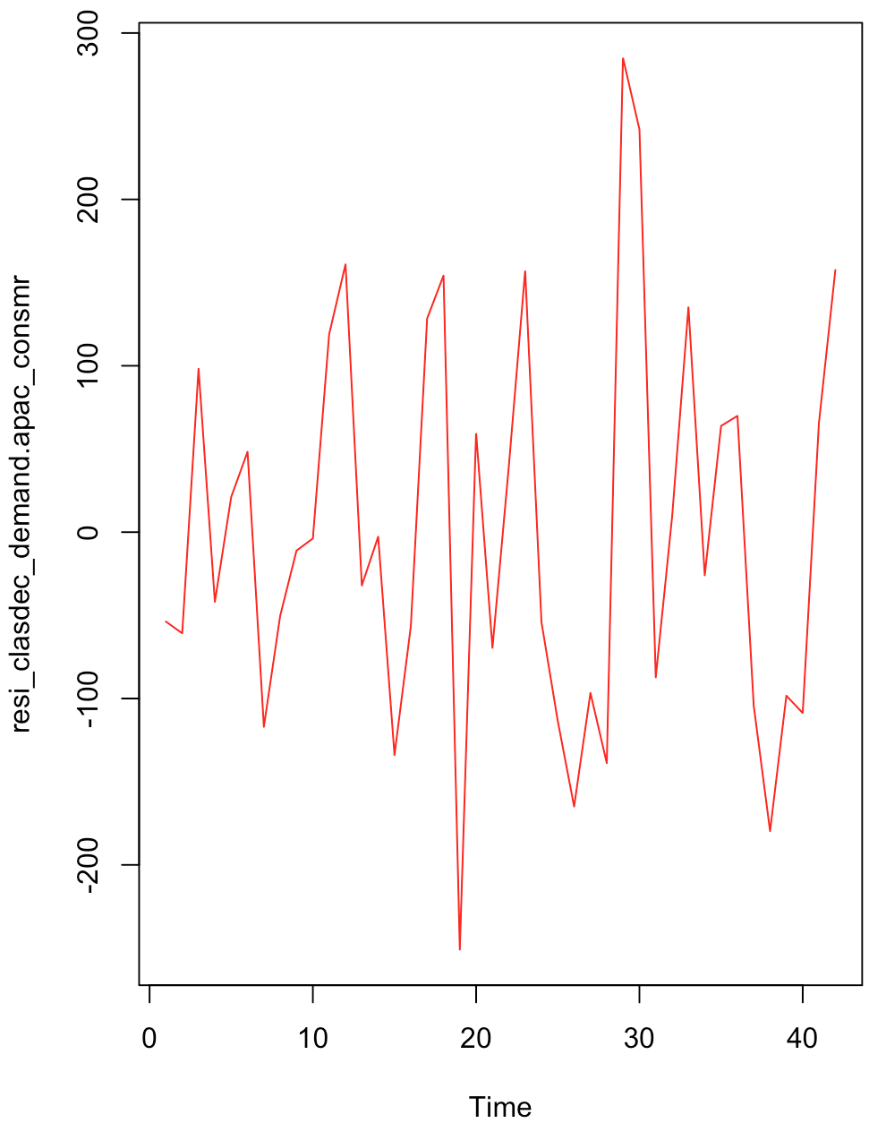
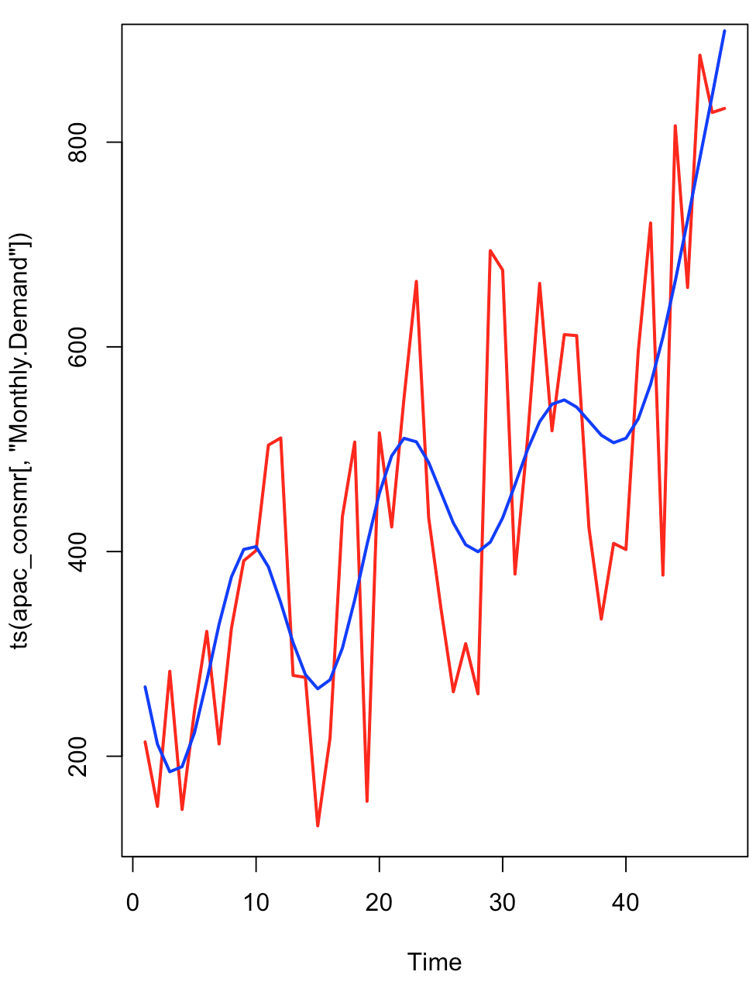
Model Building - Demand(Quantity) for APAC-Consumer (Cont 2..)
Classical Decomposition Method
The residual was obtained by removing the local component as shown in the below plot(First one)
The Augmented Dickey-Fuller Test shows a p-value<0.01. This Implies that the residual after extracting the global and local components for demand is stationary.
The KPSS Test for Level Stationarity shows a p-value>0.1.This Implies that the residual after extracting the global and local components for demand is stationary.
Forecasting the Demand using classical decomposition model for next 6 months [Month Code: 43,44,45,46,47,48]gives the following Demand forecasting accuracy of Classical Decomposition model:
ME RMSE MAE MPE MAPE
Test set -23.16084 127.4945 107.1754 -8.815864 18.79196
Demand Forecast for 6 months(43,44,45,46,47,48
Residual plot

Slide 13
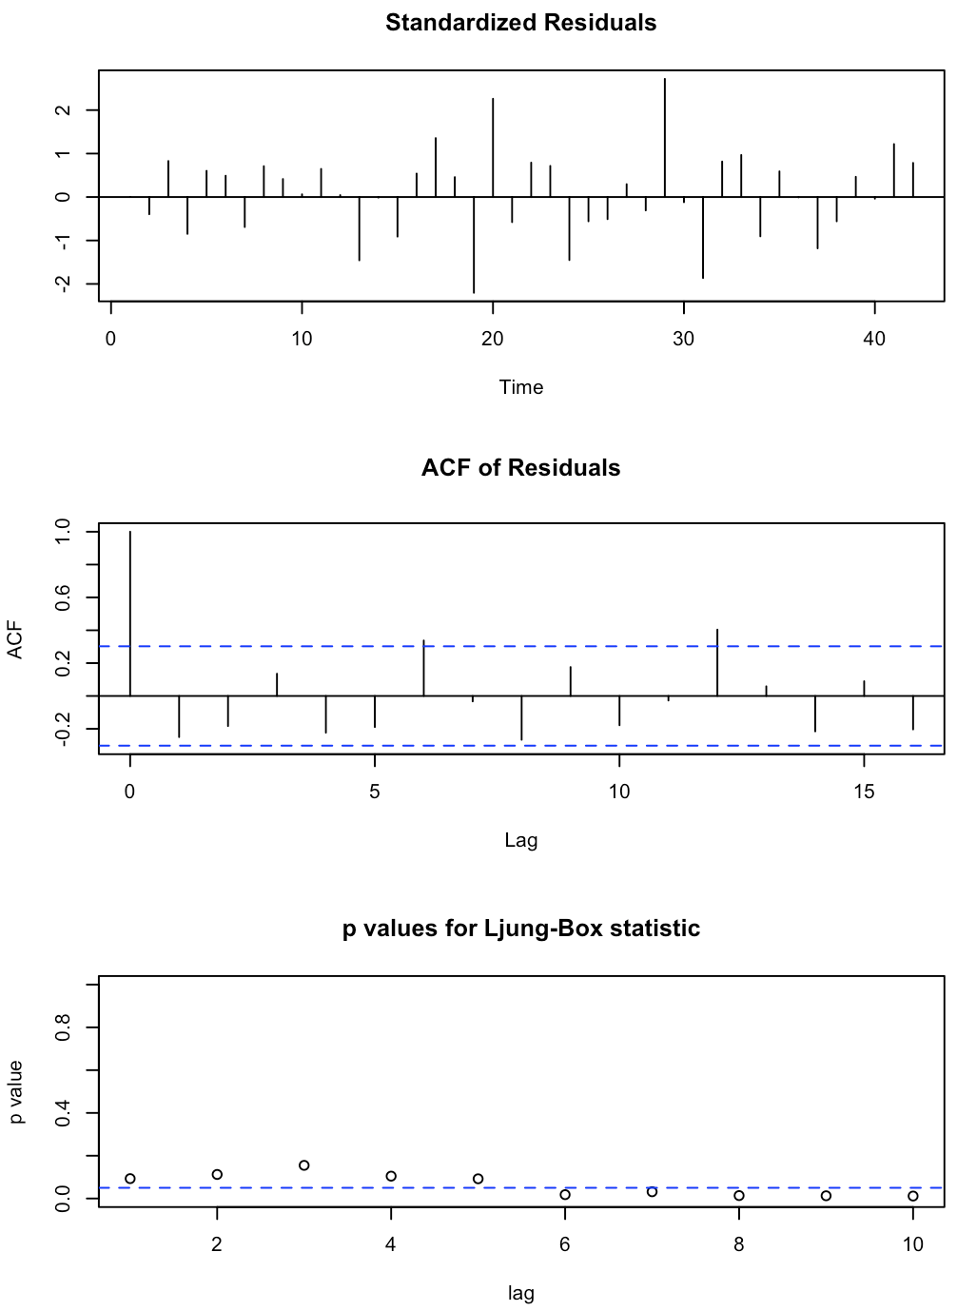
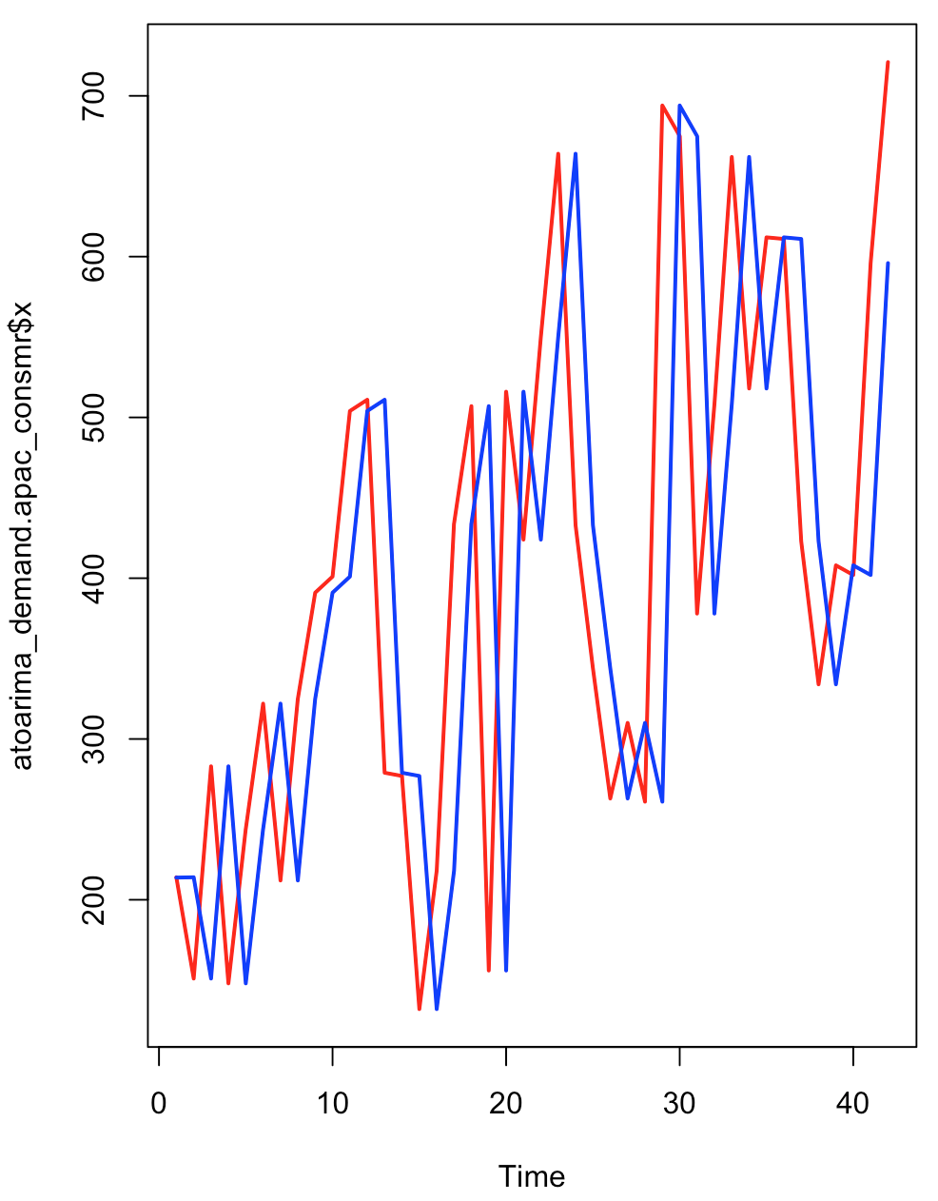
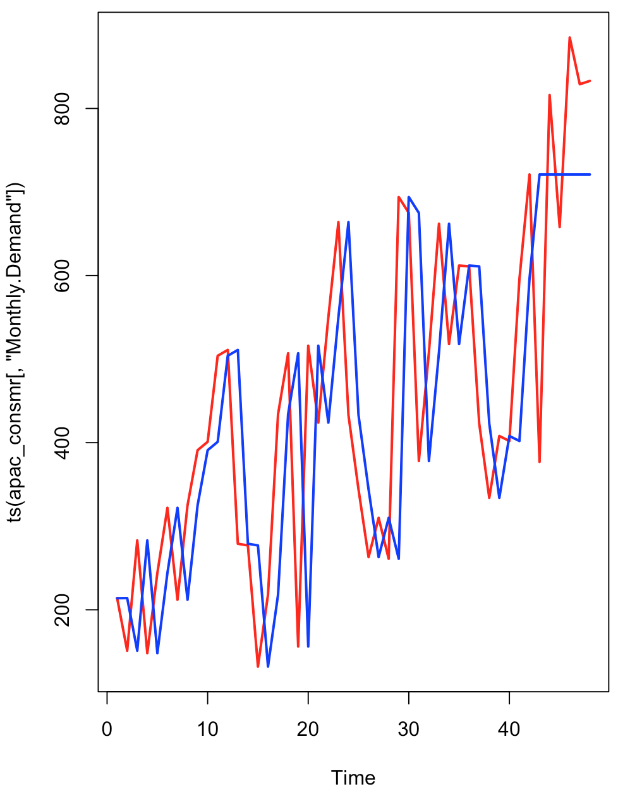
Model Building - Demand(Quantity) for APAC-Consumer (Cont 3..)
Auto Arima Method
The auto arima model was of ARIMA(0,1,0) ; This implies that 1 stage differencing was performed.
sigma^2 estimated as 25366 | log likelihood=-266.07 | AIC=534.14 | AICc=534.24 | BIC=535.85
We Obtained the following results on the Demand forecasting accuracy of Auto ARIMA model:
ME RMSE MAE MPE MAPE
Test set 12 174.372 147.6667 -7.362467 26.24458
Original Demand Time Series in Red and the Fitted Auto Arima Model in Blue.
Forecast - Original Demand Time Series in Red and the Fitted Auto Arima Model in Blue.

Slide 14
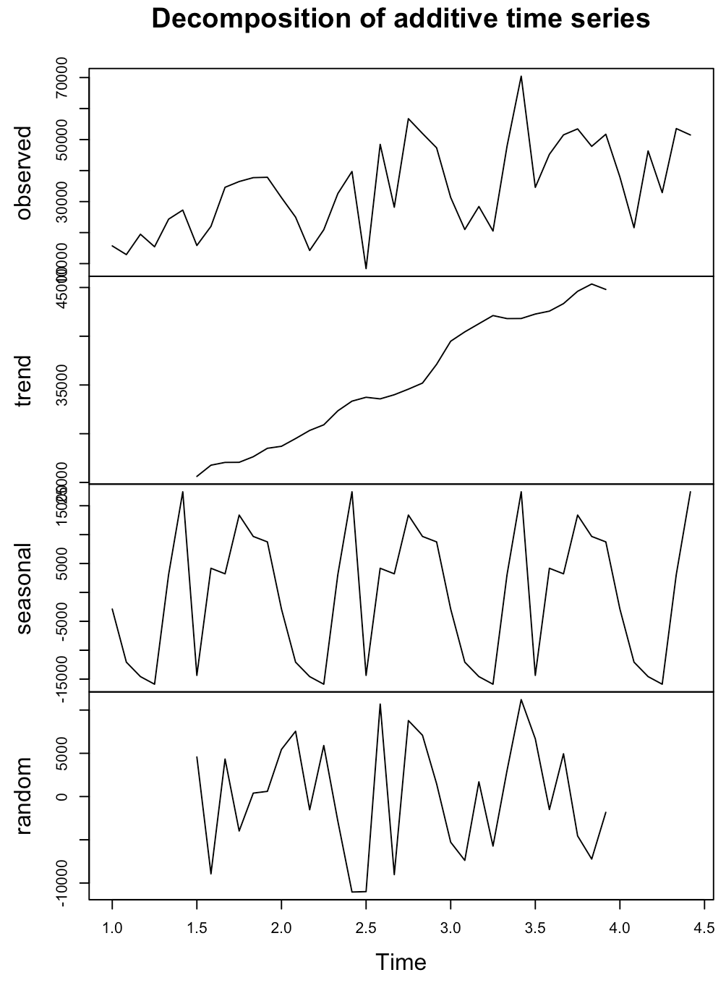
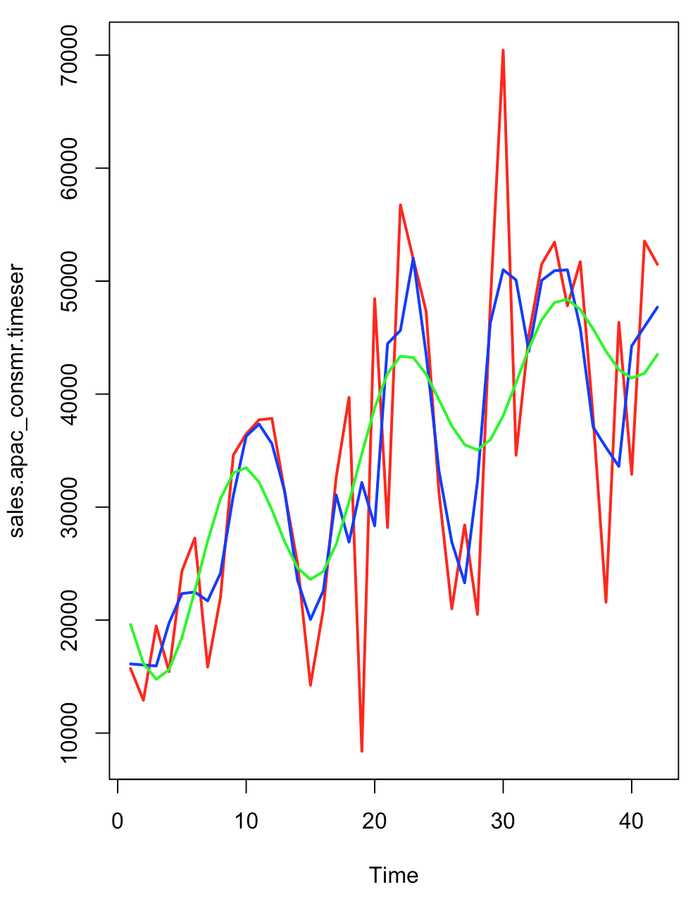
Model Building - Sales for APAC-Consumer
Classical Decomposition Method
Classical Decomposition Method
It is Evident from the decomposition that the Demand:
[1] A linearly increasing trend with a positive slope
[2] A high amplitude sinusoidal seasonality ranging between -15000 to +15000 units.
[3] The Sales Time Series will be and Additive Forecasting Model
Model Building
In the graph ,
[1]The red line indicates the original time series of APAC-Quantity .
[2]The Blue line indicates the smoothed line using moving average function.
[3]The green line is the linear model built using the function Sin,Cosine and Poly function of degree 1.
Accuracy of the global prediction
ME RMSE MAE MPE MAPE
Test set -1.697715e-11 5809.805 4747.736 -2.687435 14.6557

Slide 15
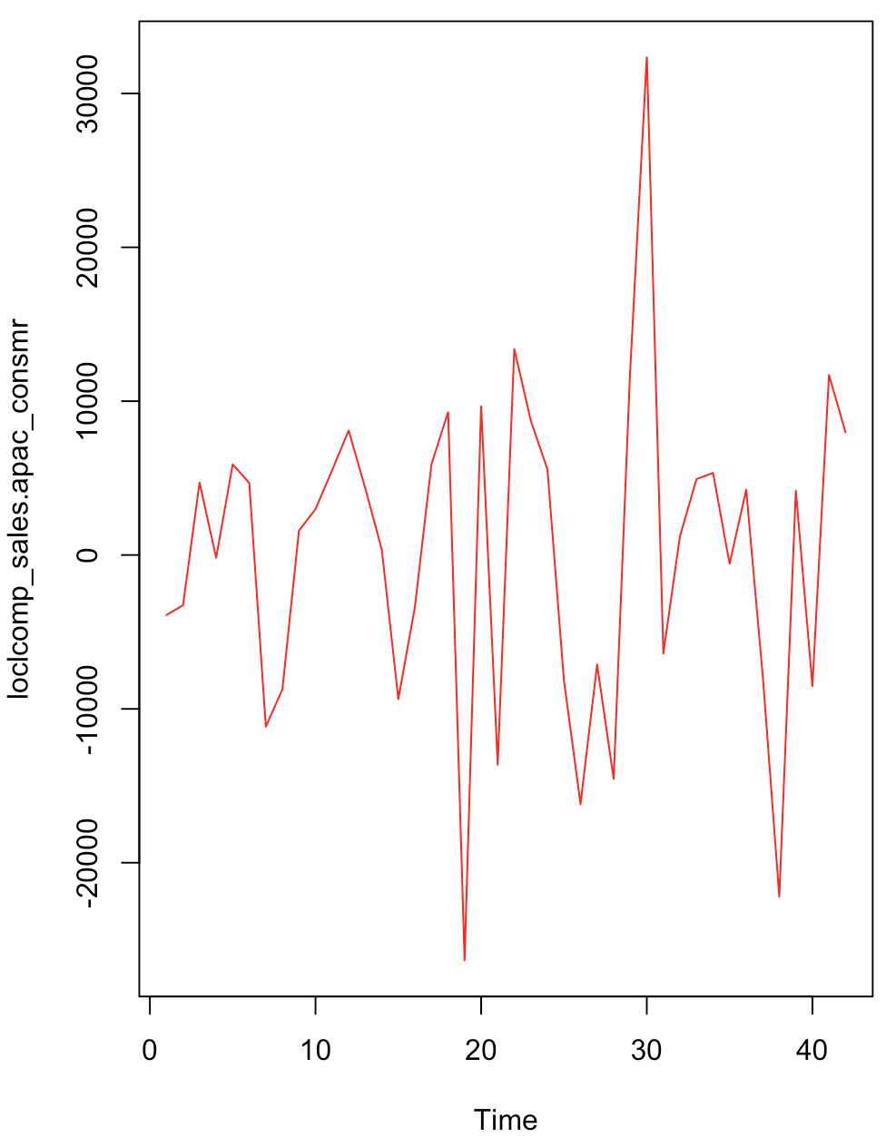
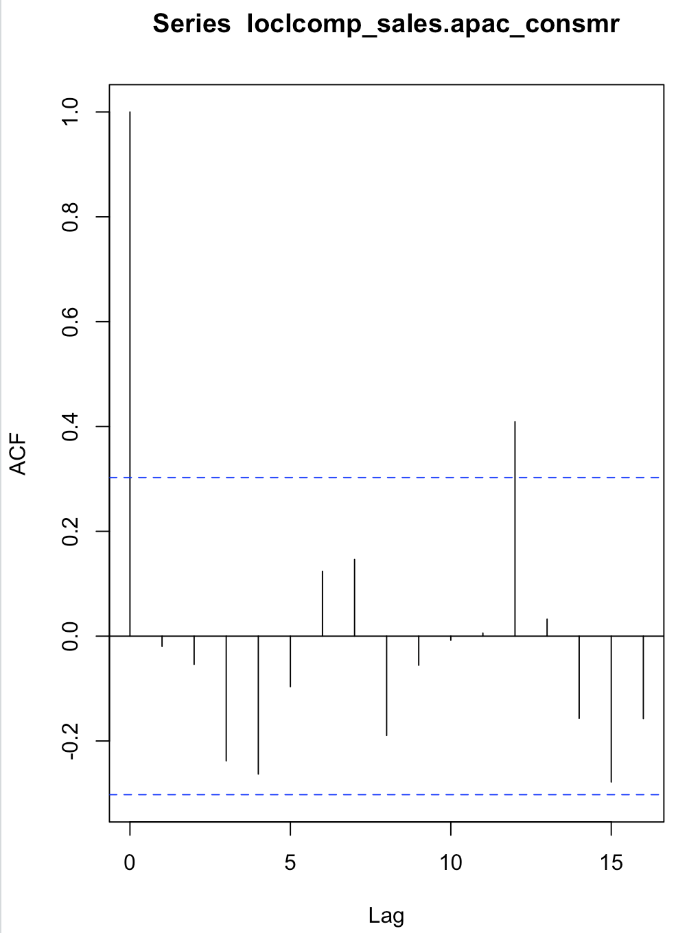
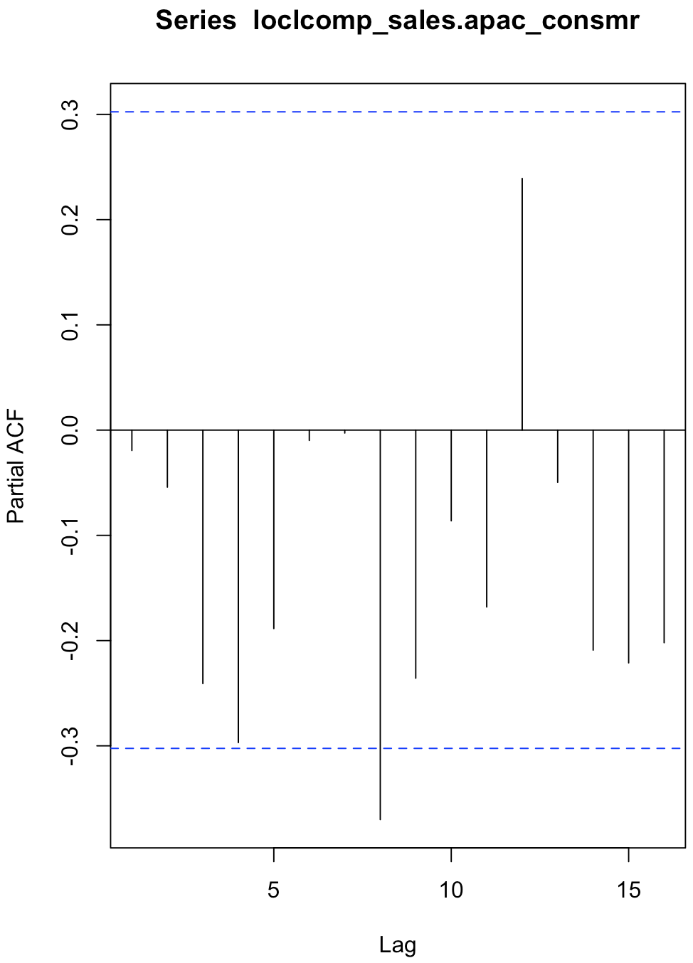
Model Building - Sales for APAC-Consumer(Cont1..)
Classical Decomposition Method
The first graph is a visual of the local component that was derived after removing global trend from the original time series.
The ACF and PACF plot indicate that the local component is a weakly stationary series.
Further modelling the local component with ARIMA gives ARIMA(0,0,0) with zero mean ; This implies that there is no AR(p) or MA(q) series in the local component.

Slide 16
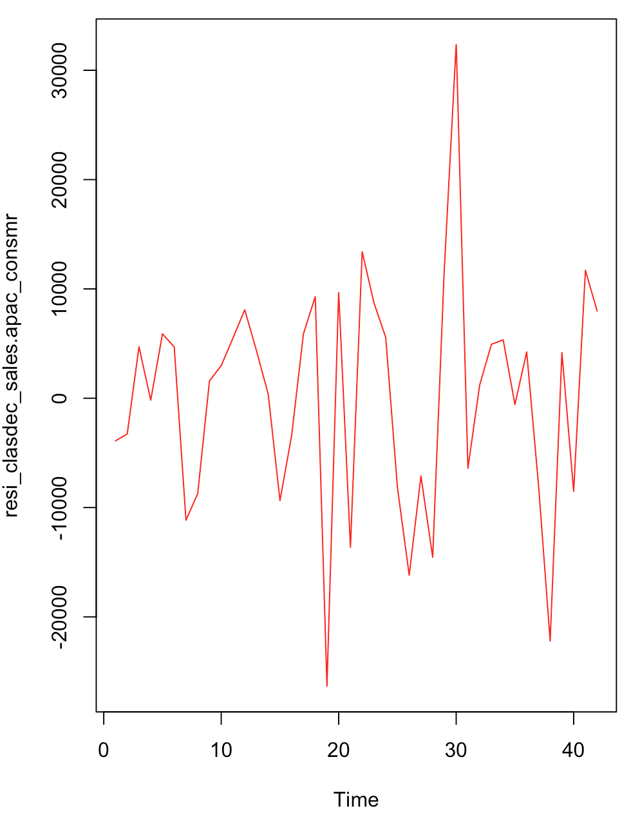
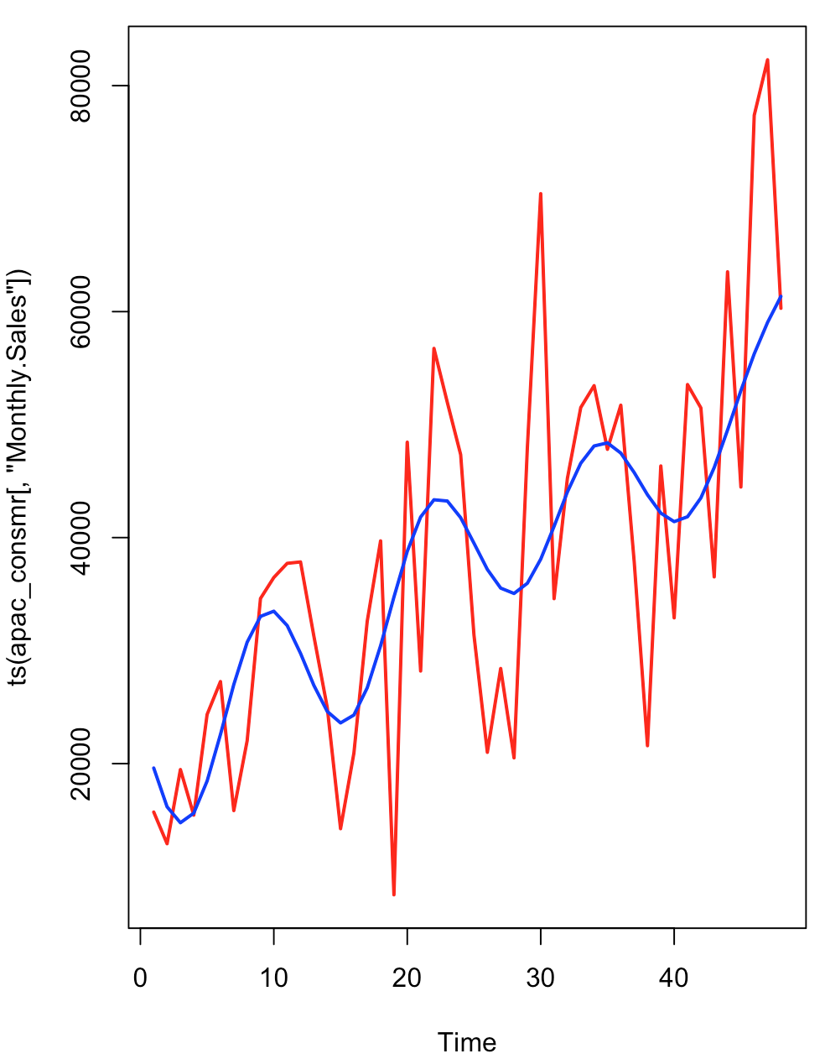
Model Building - Sales for APAC-Consumer(Cont2..)
Classical Decomposition Method
The residual was obtained by removing the local component as shown in the below plot(First one)
The Augmented Dickey-Fuller Test shows a p-value<0.01. This Implies that the residual after extracting the global and local components for demand is stationary.
The KPSS Test for Level Stationarity shows a p-value>0.1.This Implies that the residual after extracting the global and local components for demand is stationary.
Forecasting the Demand using classical decomposition model for next 6 months [Month Code: 43,44,45,46,47,48]gives the following Demand forecasting accuracy of Classical Decomposition model:
ME RMSE MAE MPE MAPE
Test set 6515.587 14997.64 12937.14 5.024684 20.83351
Demand Forecast for 6 months(43,44,45,46,47,48
Residual plot

Slide 17
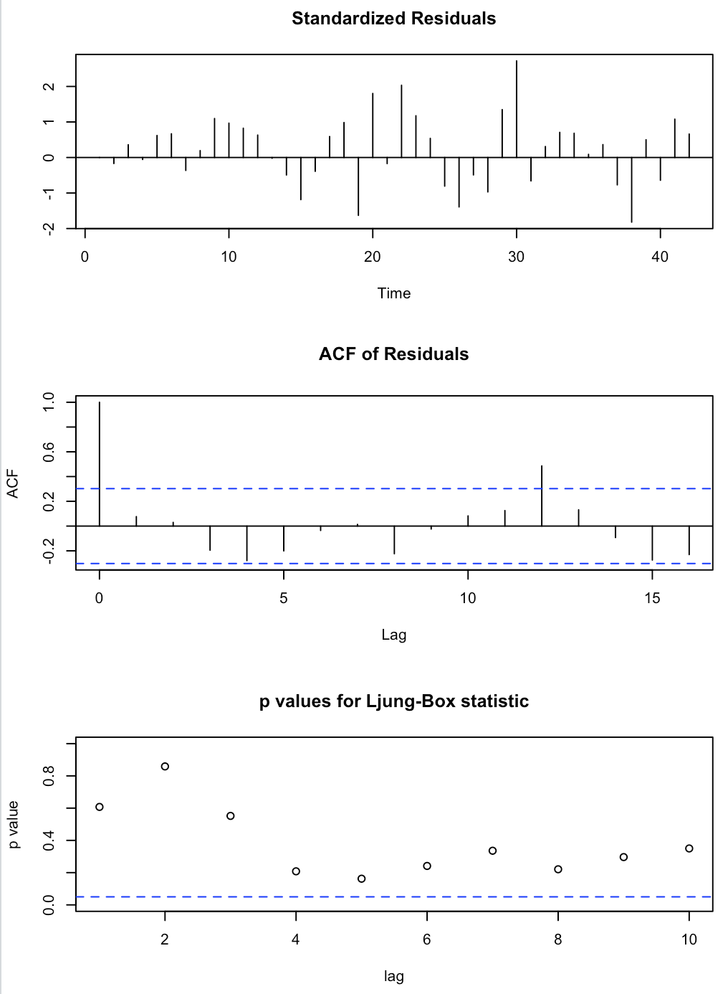
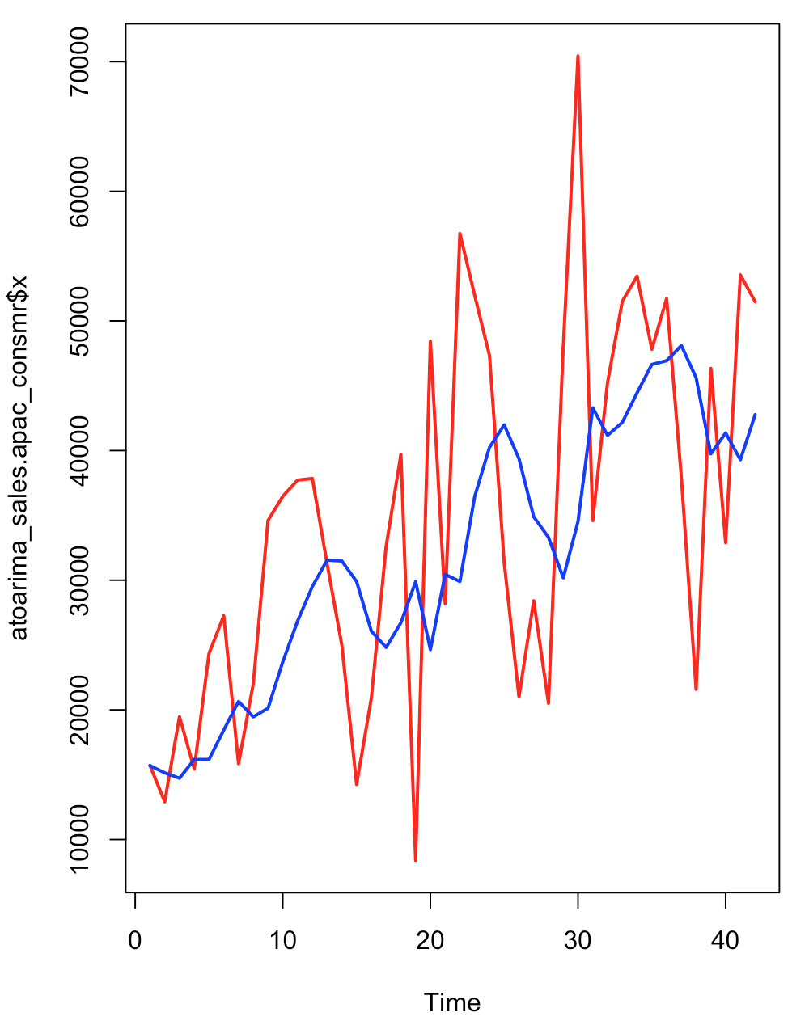
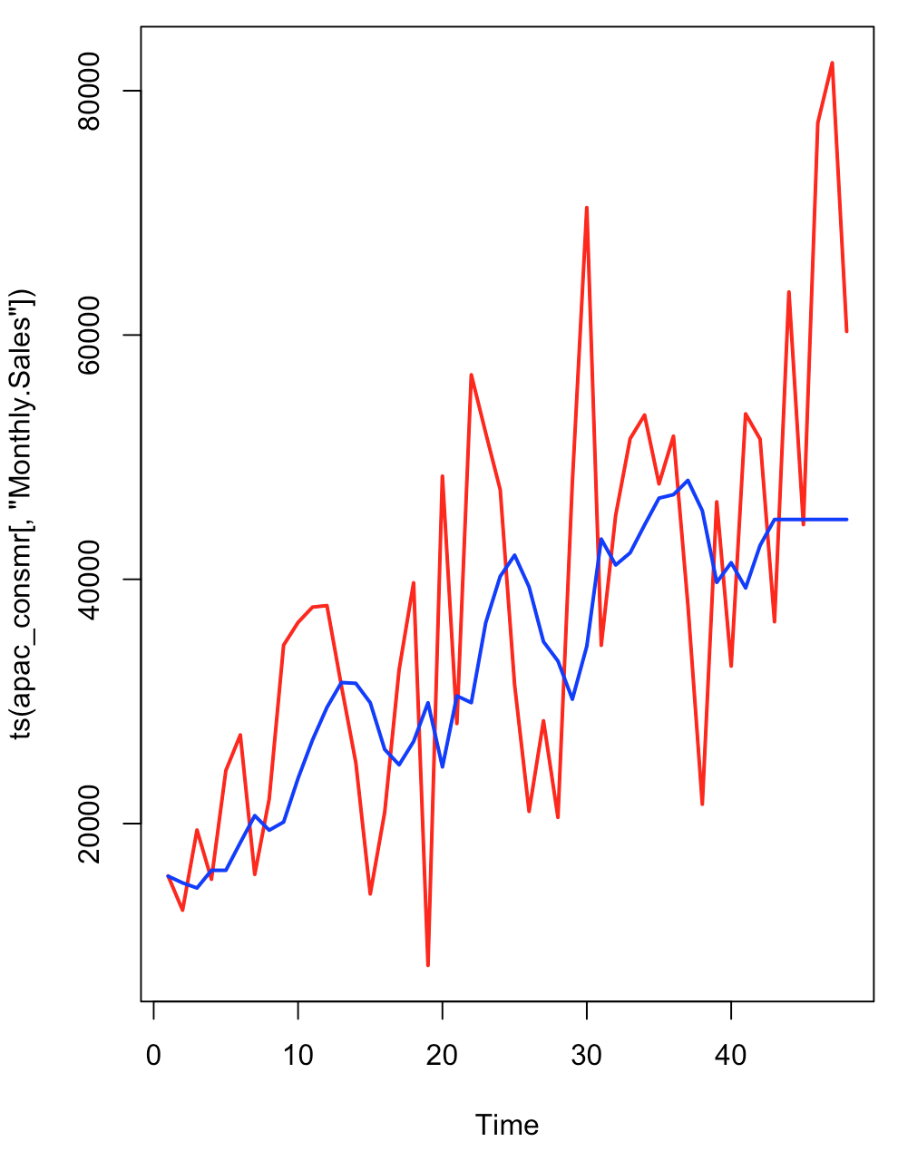
Model Building - Sales for APAC-Consumer(Cont3..)
Auto Arima Method
The auto arima model was of ARIMA(0,1,1) .This implies that 1 stage differencing was performed and the resulting timeseries was modeled as MA(1).
The standard error for the MA(1) coefficient is 18.3% of the coefficient. This is relatively high but we will accept it with caution. sigma^2 estimated as 174361546 | log likelihood=-447.11 | AIC=898.23 | AICc=898.55 | BIC=901.66
We Obtained the following results on the Demand forecasting accuracy of Auto ARIMA model:
ME RMSE MAE MPE MAPE
Test set 15848.24 22755.75 18780.19 19.73091 27.68952
Original Demand Time Series in Red and the Fitted Auto Arima Model in Blue.
Forecast - Original Demand Time Series in Red and the Fitted Auto Arima Model in Blue.

Slide 18
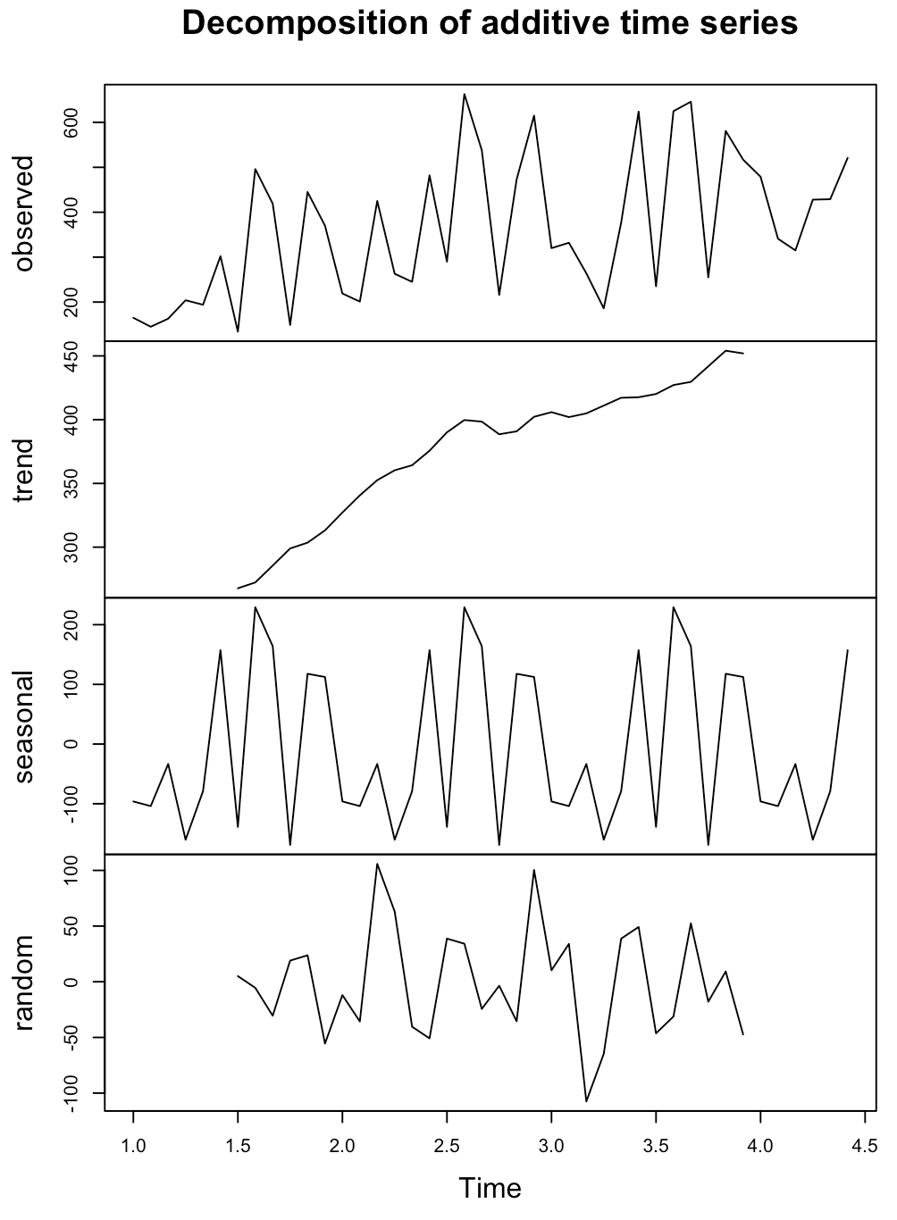
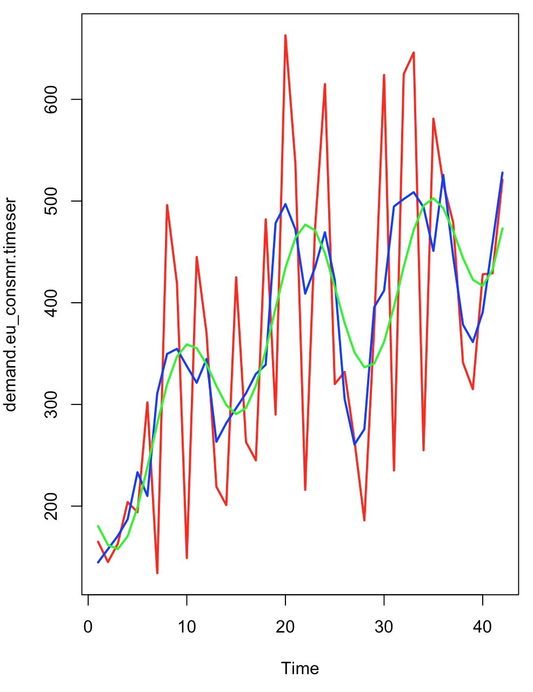
Model Building - Demand(Quantity) for EU-Consumer
Classical Decomposition Method
Classical Decomposition Method
It is Evident from the decomposition that the Demand:
[1] A linearly increasing trend with a positive slope
[2] A low amplitude sinusoidal seasonality ranging between -150 to +200 units.
[3] The Demand Time Series will be and Additive Forecasting Model
Model Building
In the graph ,
[1]The red line indicates the original time series of APAC-Quantity .
[2]The Blue line indicates the smoothed line using moving average function.
[3]The green line is the linear model built using the function Sin,Cosine and Poly function of degree 1.
Accuracy of the global prediction
ME RMSE MAE MPE MAPE
Test set 1.827226e-14 44.65191 36.74022 -1.516791 10.55574

Slide 19
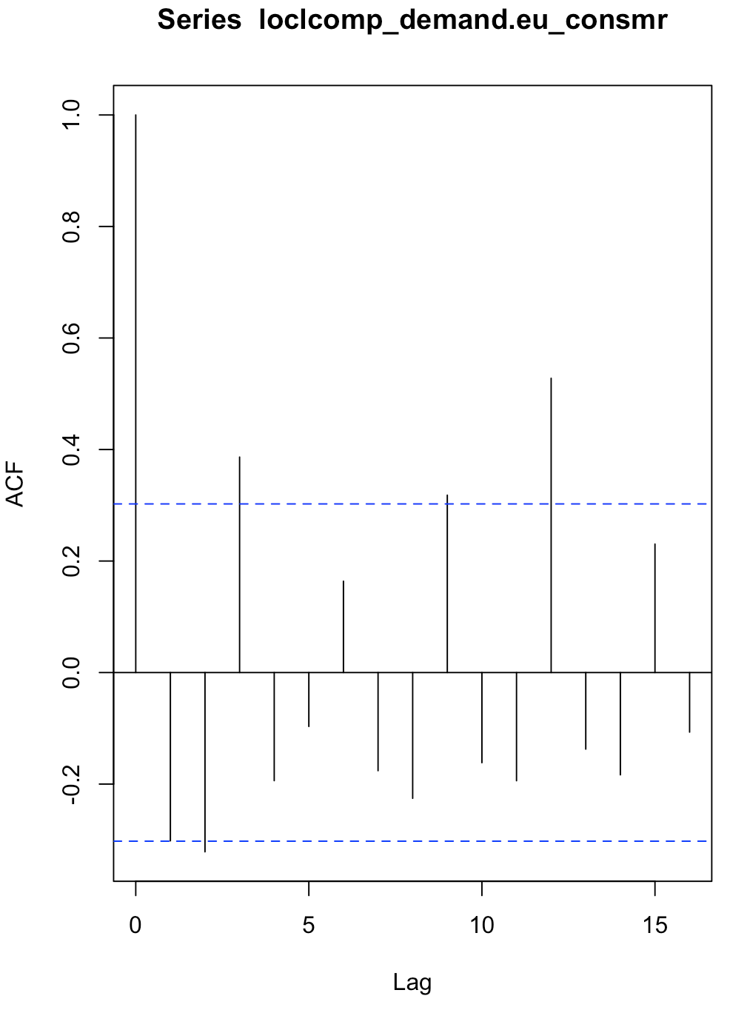
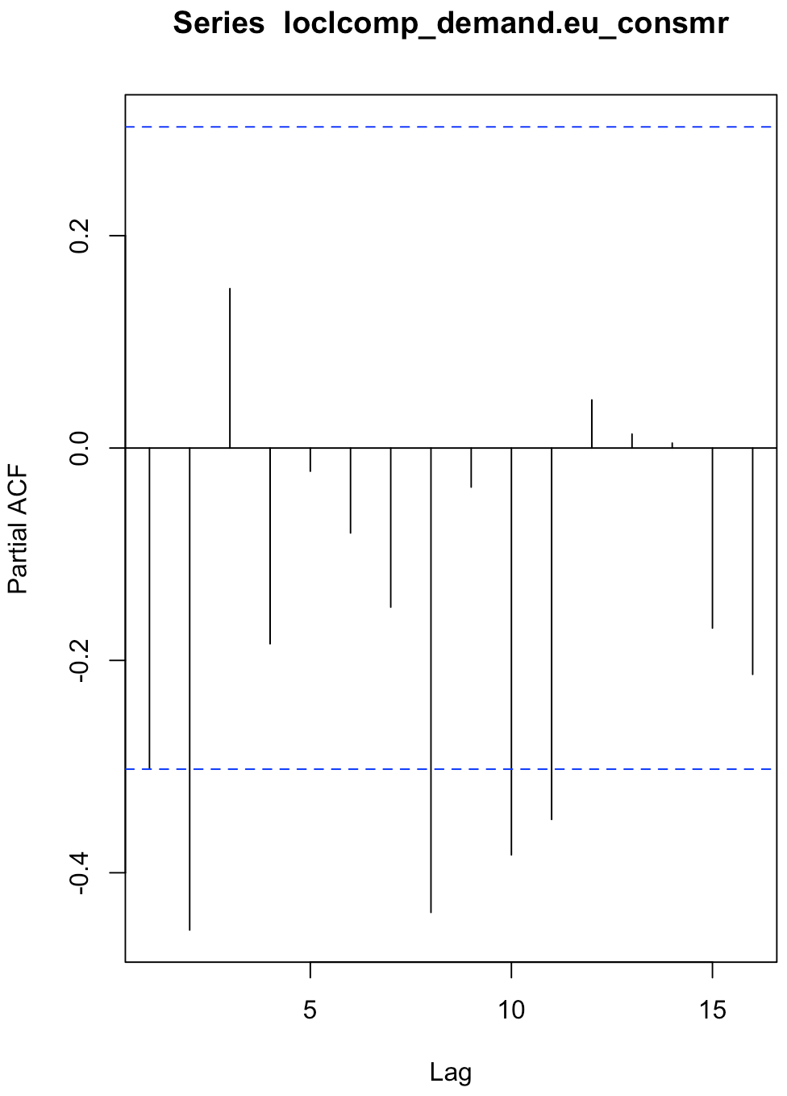
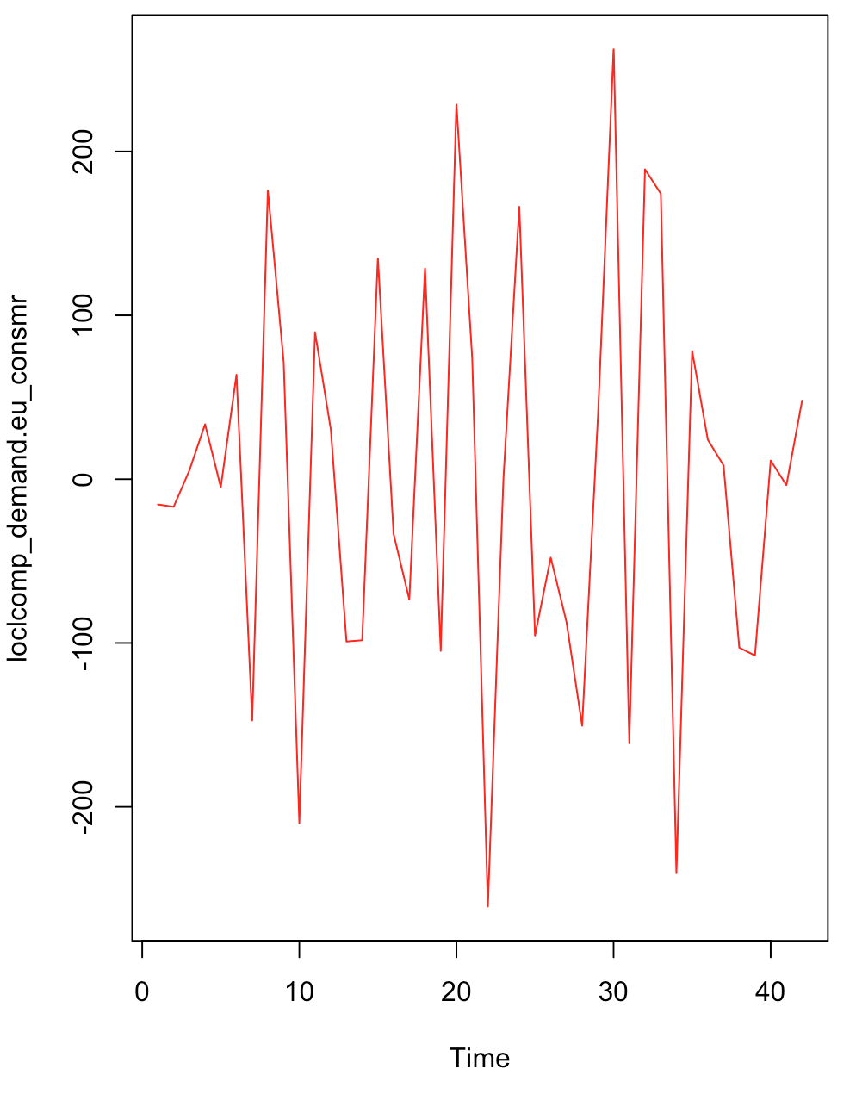
Model Building - Demand(Quantity) for EU-Consumer (Cont 1..)
Classical Decomposition Method
The first graph is a visual of the local component that was derived after removing global trend from the original time series.
The ACF and PACF plot indicate that the local component is a weakly stationary series.
Further modelling the local component with ARIMA gives ARIMA(0,0,0) with zero mean ; This implies that there is no AR(p) or MA(q) series in the local component.sigma^2 estimated as 15119 | log likelihood=-261.69 | AIC=525.39 | AICc=525.49 | BIC=527.13

Slide 20
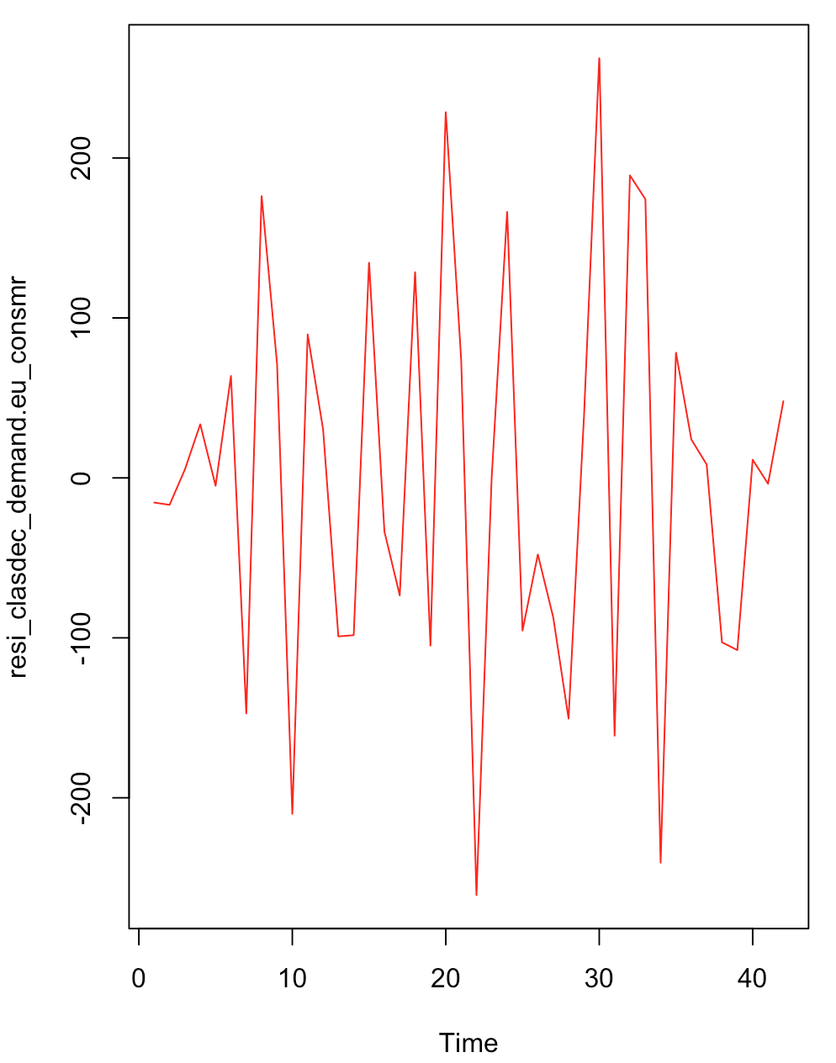
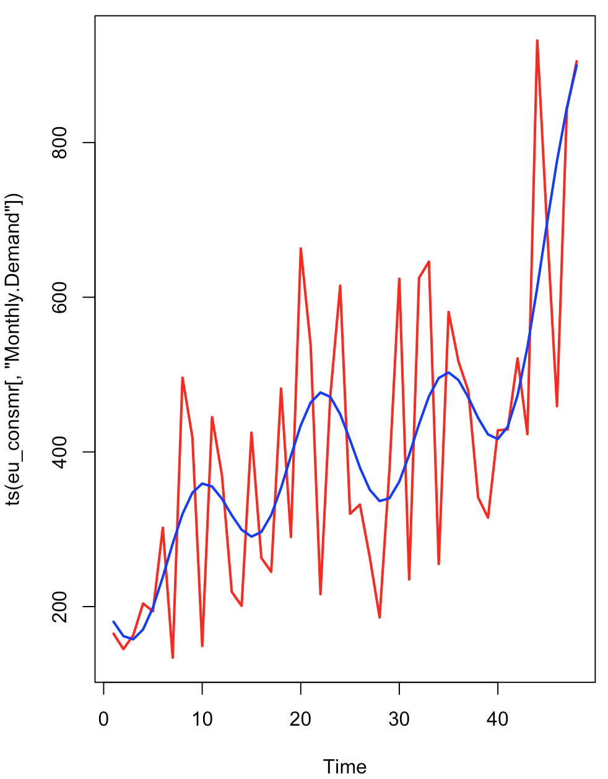
Model Building - Demand(Quantity) for EU-Consumer (Cont 2..)
Classical Decomposition Method
The residual was obtained by removing the local component as shown in the below plot(First one)
The Augmented Dickey-Fuller Test shows a p-value=0.02453. This Implies that the residual after extracting the global and local components for demand is stationary.
The KPSS Test for Level Stationarity shows a p-value>0.1.This Implies that the residual after extracting the global and local components for demand is stationary.
Forecasting the Demand using classical decomposition model for next 6 months [Month Code: 43,44,45,46,47,48]gives the following Demand forecasting accuracy of Classical Decomposition model:
# ME RMSE MAE MPE MAPE
#Test set -19.25783 189.3226 127.333 -10.38272 21.98432
Demand Forecast for 6 months(43,44,45,46,47,48
Residual plot

Slide 21
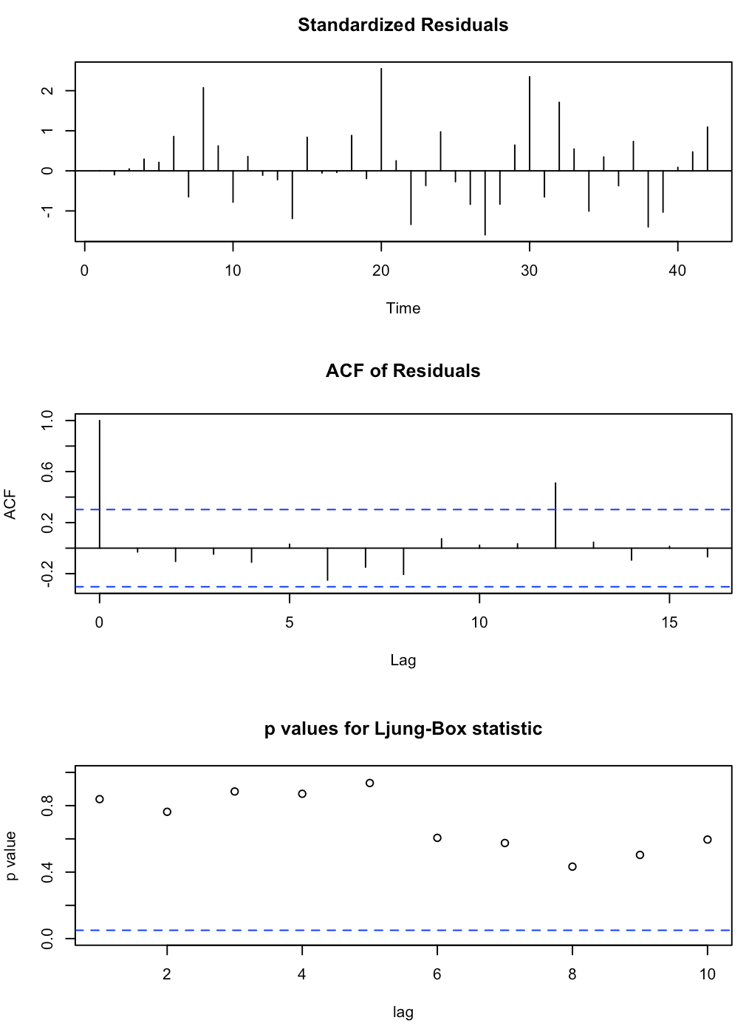
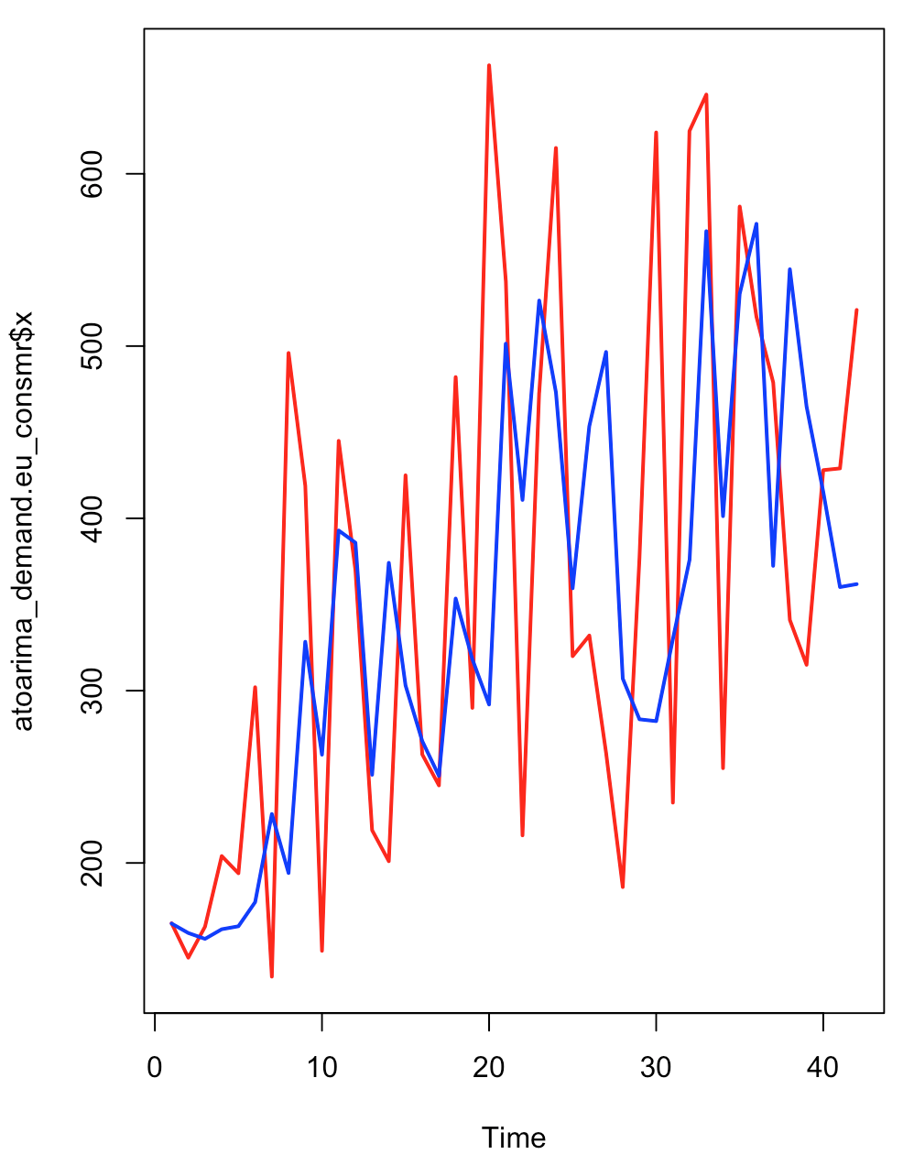
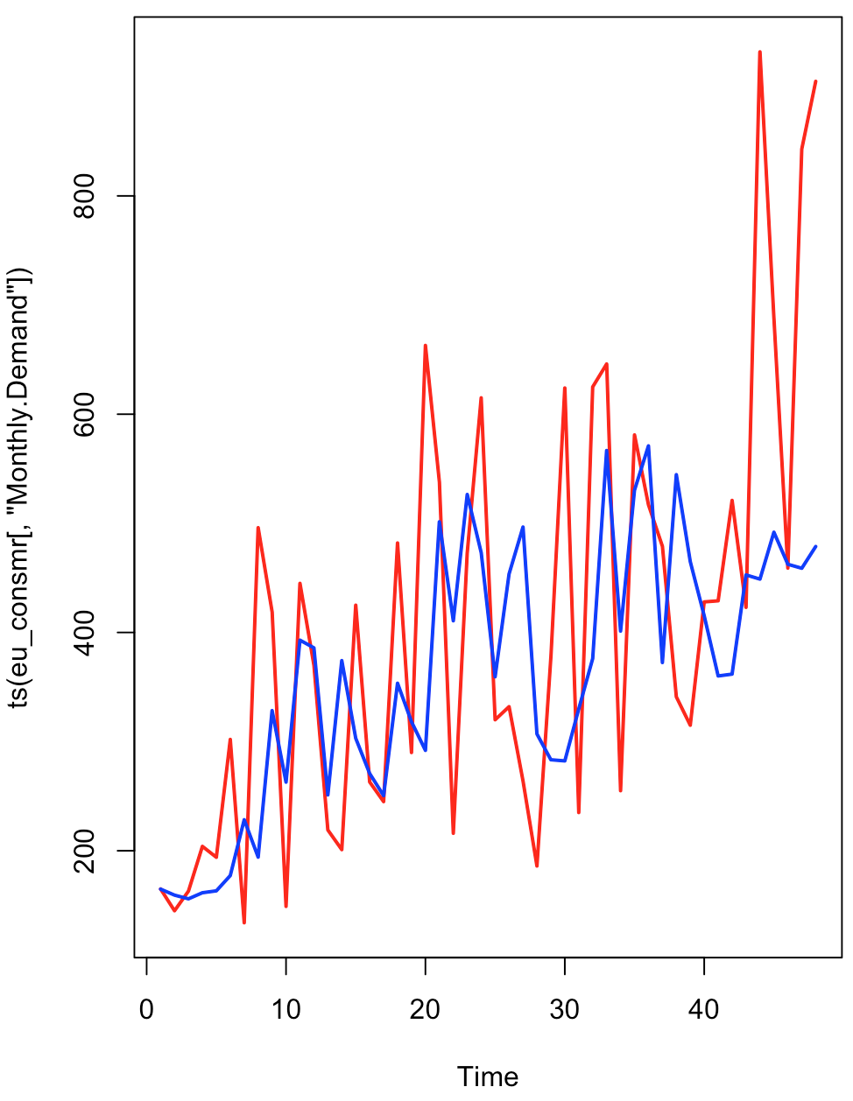
Model Building - Demand(Quantity) for EU-Consumer (Cont 3..)
Auto Arima Method
The auto arima model was of ARIMA(2,1,0) ; This implies that 1 stage differencing was performed.Following which it was modeled as an AR(2) model.
The coefficients of the AR(2) model have a standard error of 16.16% and 20.2% of their respective coefficients. These values are relatively high but we will accept it with caution.
sigma^2 estimated as 21185 | log likelihood=-261.9 | AIC=529.8 | AICc=530.44 | BIC=534.94
We Obtained the following results on the Demand forecasting accuracy of Auto ARIMA model:
ME RMSE MAE MPE MAPE
Test set 242.746 316.7626 253.8108 27.53891 30.13319
Original Demand Time Series in Red and the Fitted Auto Arima Model in Blue.
Forecast - Original Demand Time Series in Red and the Fitted Auto Arima Model in Blue.

Slide 22
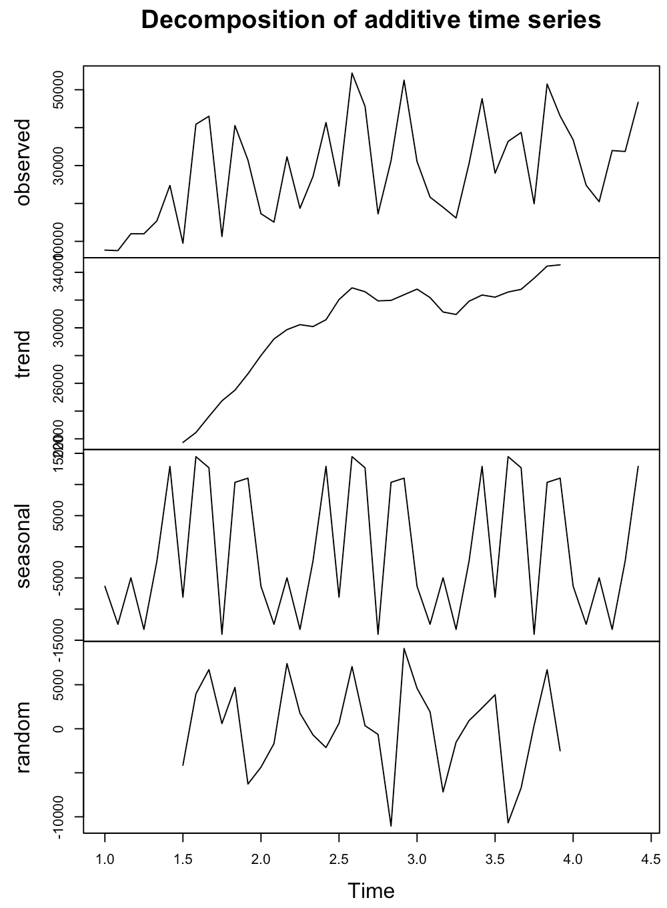
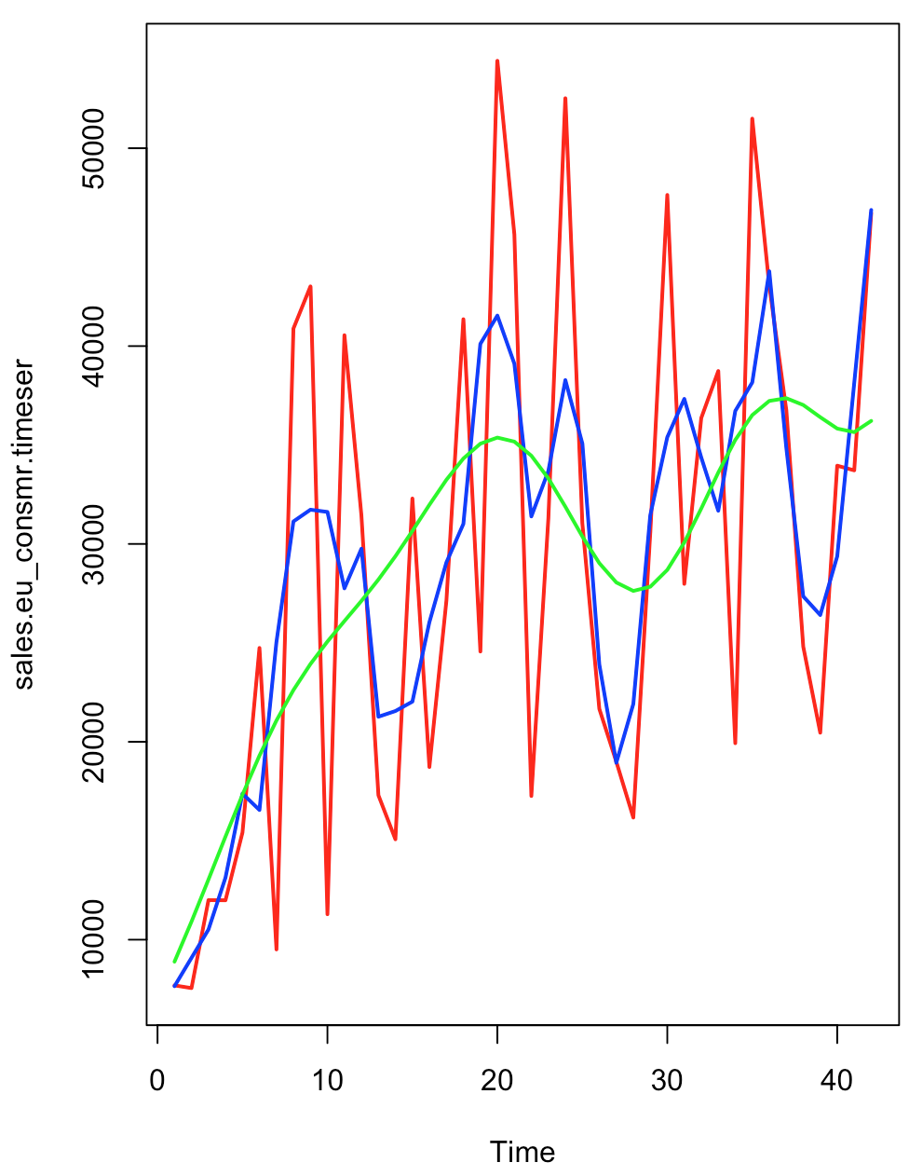
Model Building - Sales for EU-Consumer
Classical Decomposition Method
Classical Decomposition Method
It is Evident from the decomposition that the Demand:
[1] A linearly increasing trend with a positive slope
[2] A high amplitude sinusoidal seasonality ranging between -15000 to +10000 units.
[3] The Sales Time Series will be and Additive Forecasting Model
Model Building
In the graph ,
[1]The red line indicates the original time series of APAC-Quantity .
[2]The Blue line indicates the smoothed line using moving average function.
[3]The green line is the linear model built using the function Sin,Cosine and Poly function of degree 1.
Accuracy of the global prediction
ME RMSE MAE MPE MAPE
Test set. 5.370477e-12 5554.081 4798.541 -4.289866 17.73118

Slide 23
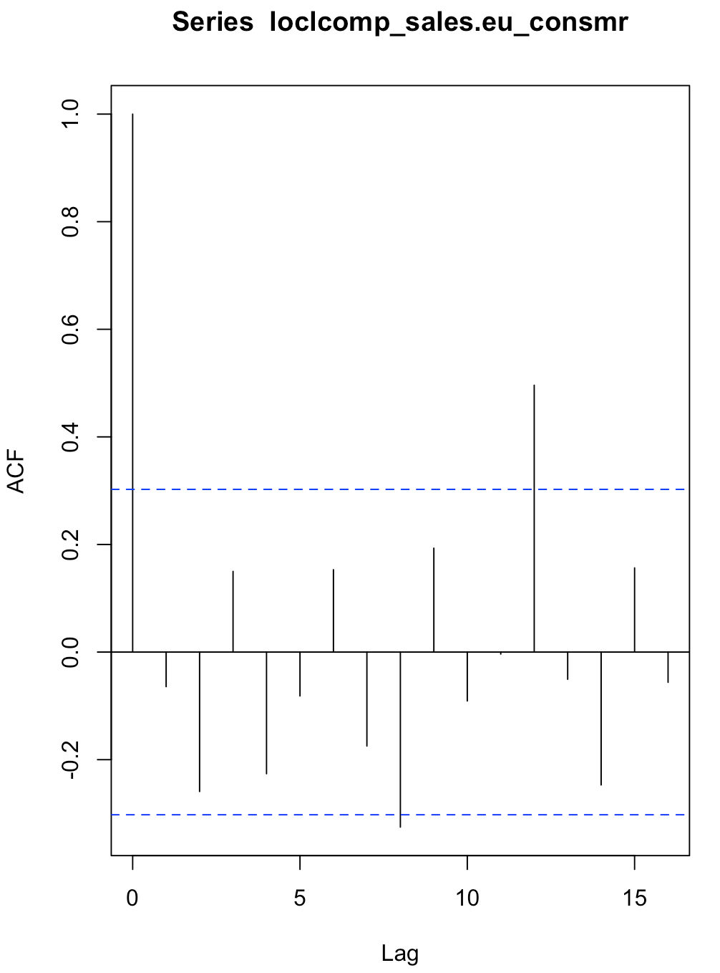
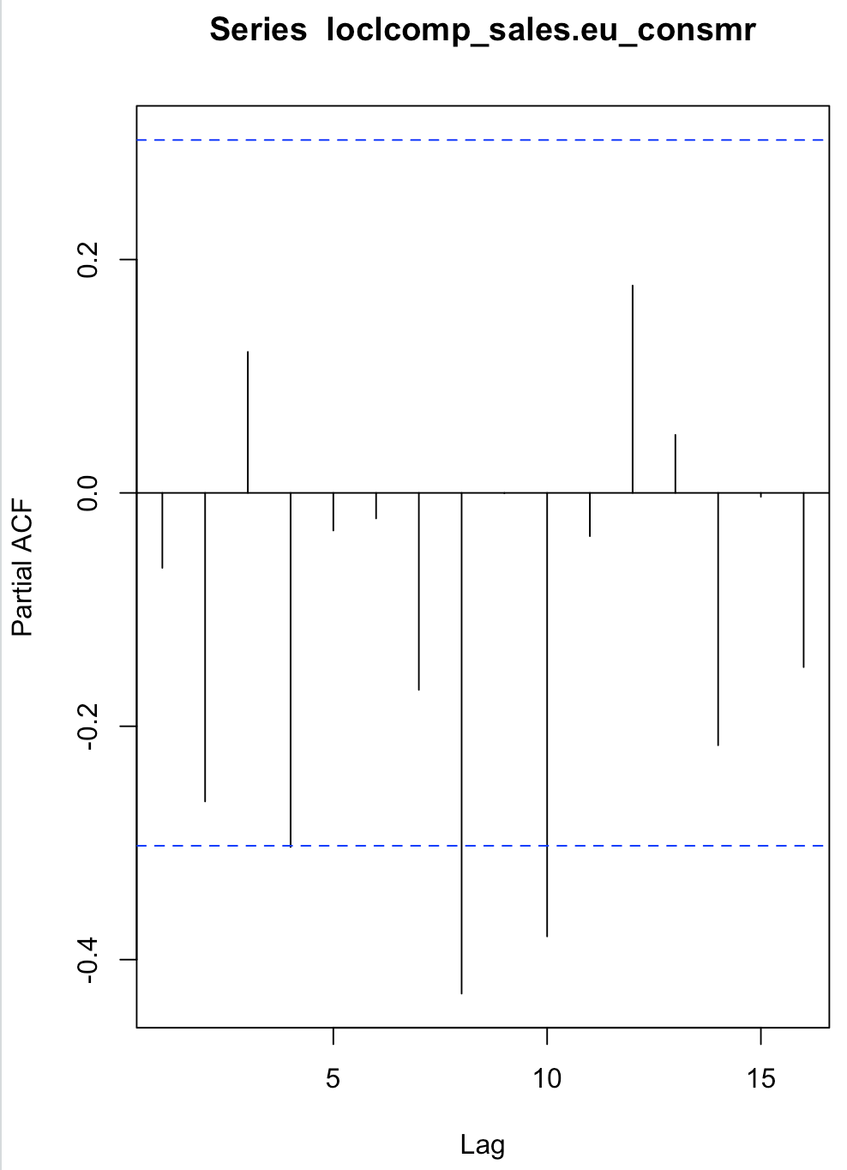
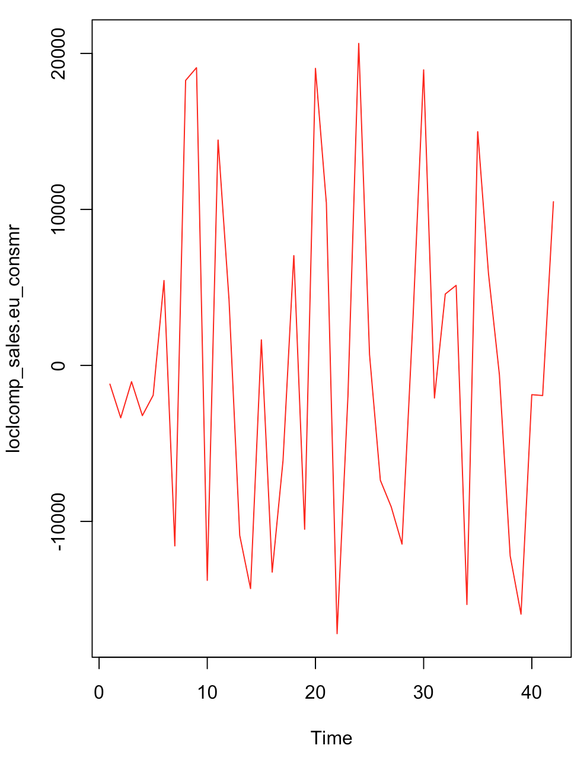
Model Building - Sales for EU-Consumer(Cont1..)
Classical Decomposition Method
The first graph is a visual of the local component that was derived after removing global trend from the original time series.
The ACF and PACF plot indicate that the local component is a weakly stationary series.
Further modelling the local component with ARIMA gives ARIMA(0,0,0) with zero mean ; This implies that there is no AR(p) or MA(q) series in the local component.

Slide 24
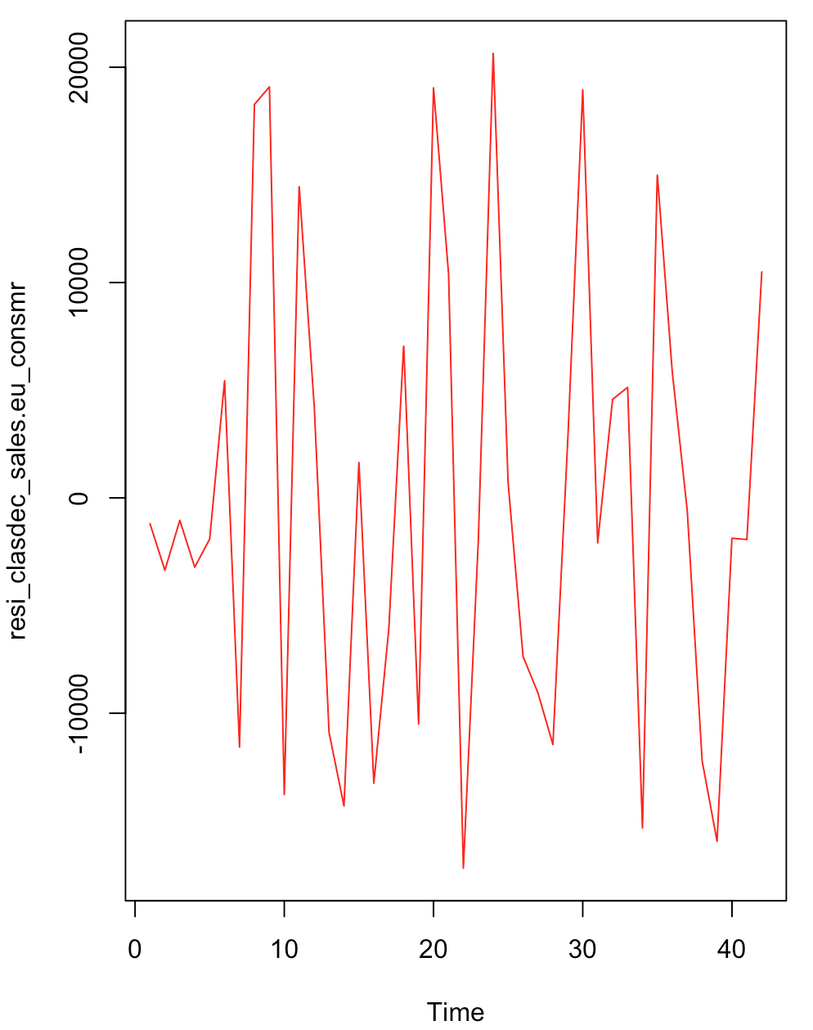
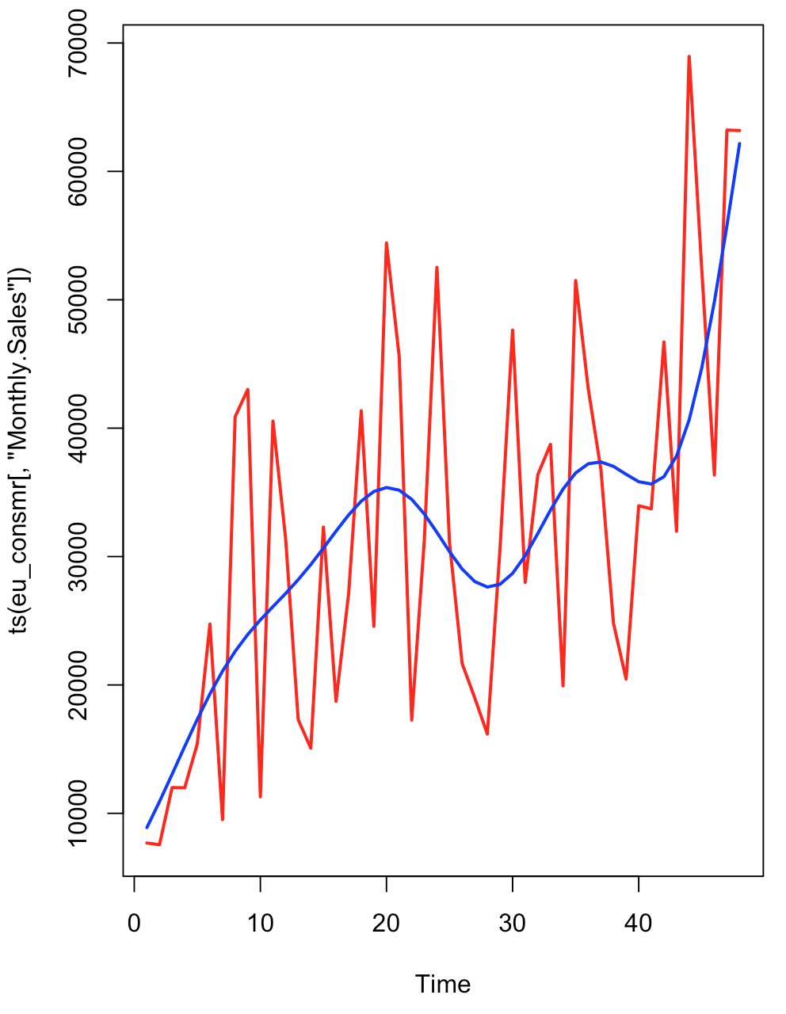
Model Building - Sales for EU-Consumer(Cont2..)
Classical Decomposition Method
The residual was obtained by removing the local component as shown in the below plot(First one)
The Augmented Dickey-Fuller Test shows a p-value=0.01311. This Implies that the residual after extracting the global and local components for demand is stationary.
The KPSS Test for Level Stationarity shows a p-value>0.1.This Implies that the residual after extracting the global and local components for demand is stationary.
Forecasting the Demand using classical decomposition model for next 6 months [Month Code: 43,44,45,46,47,48]gives the following Demand forecasting accuracy of Classical Decomposition model:
# ME RMSE MAE MPE MAPE
#Test set. 4172.431 13736.59 10622.04 2.259534 20.73958
Demand Forecast for 6 months(43,44,45,46,47,48
Residual plot

Slide 25
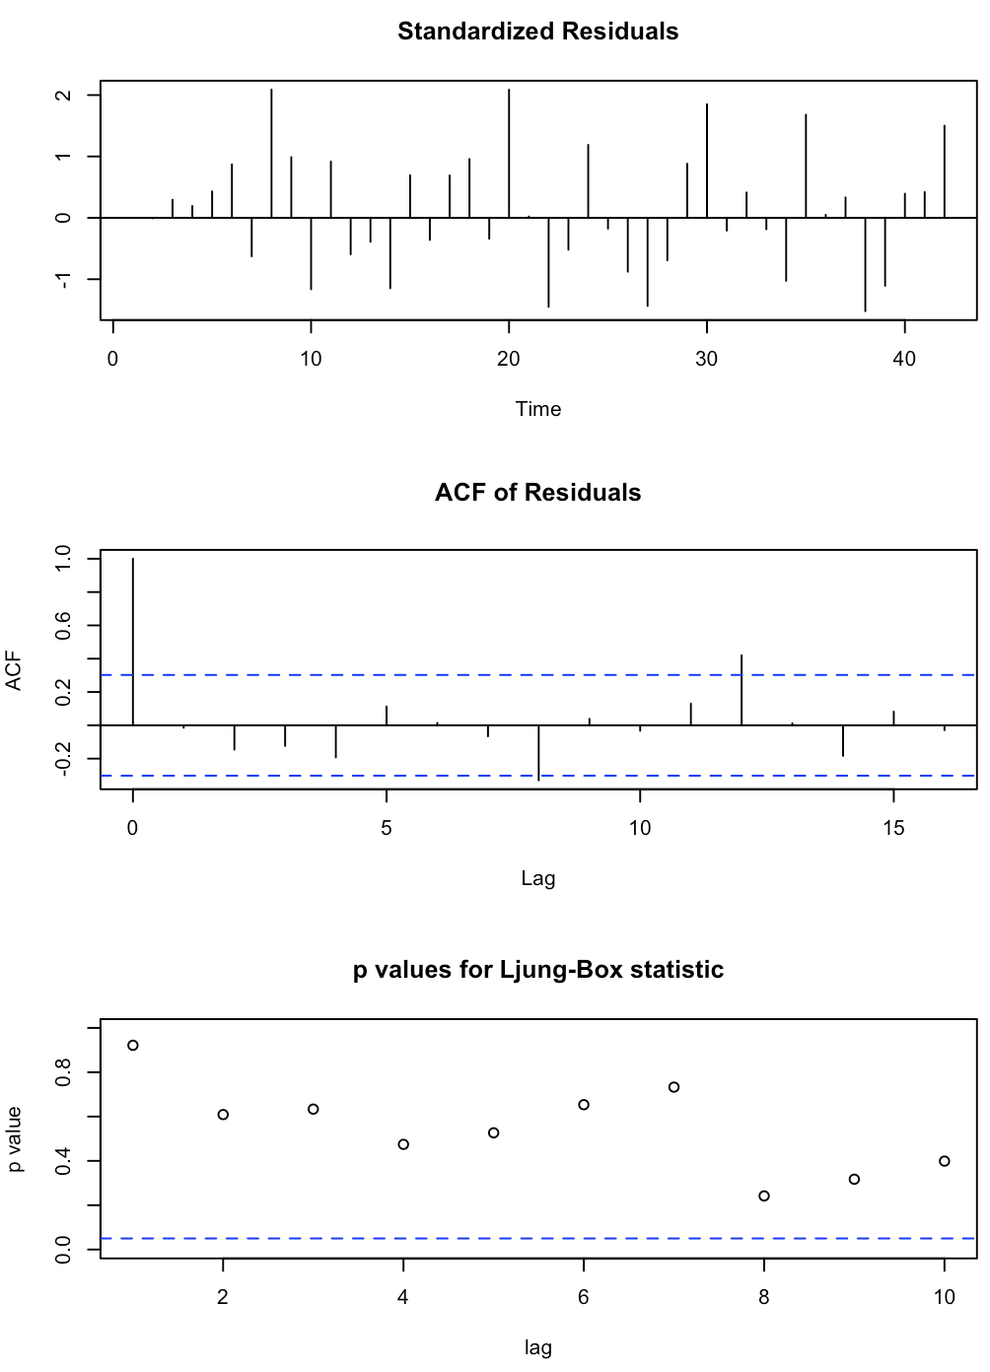
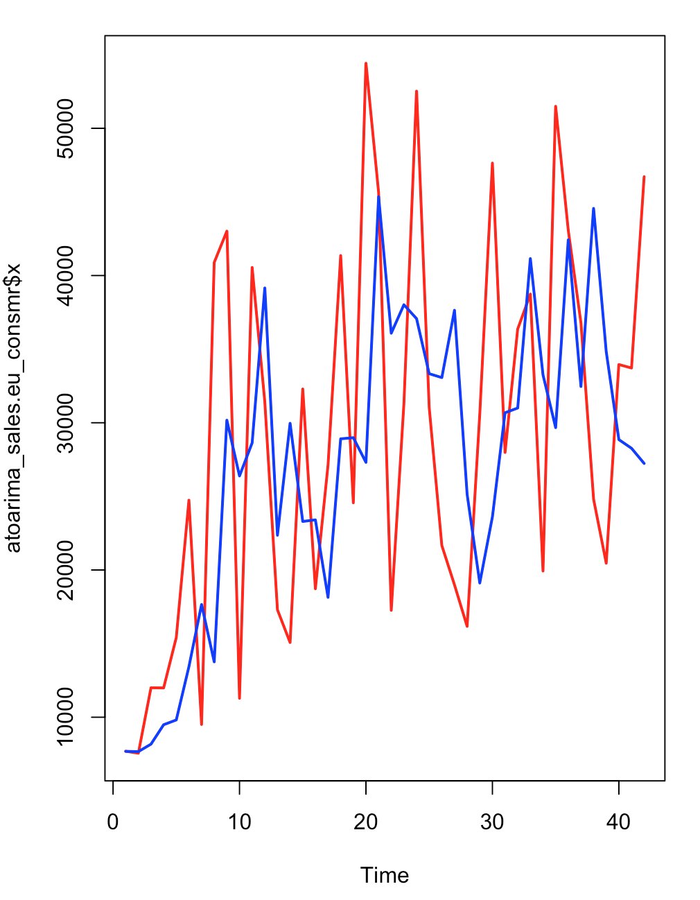
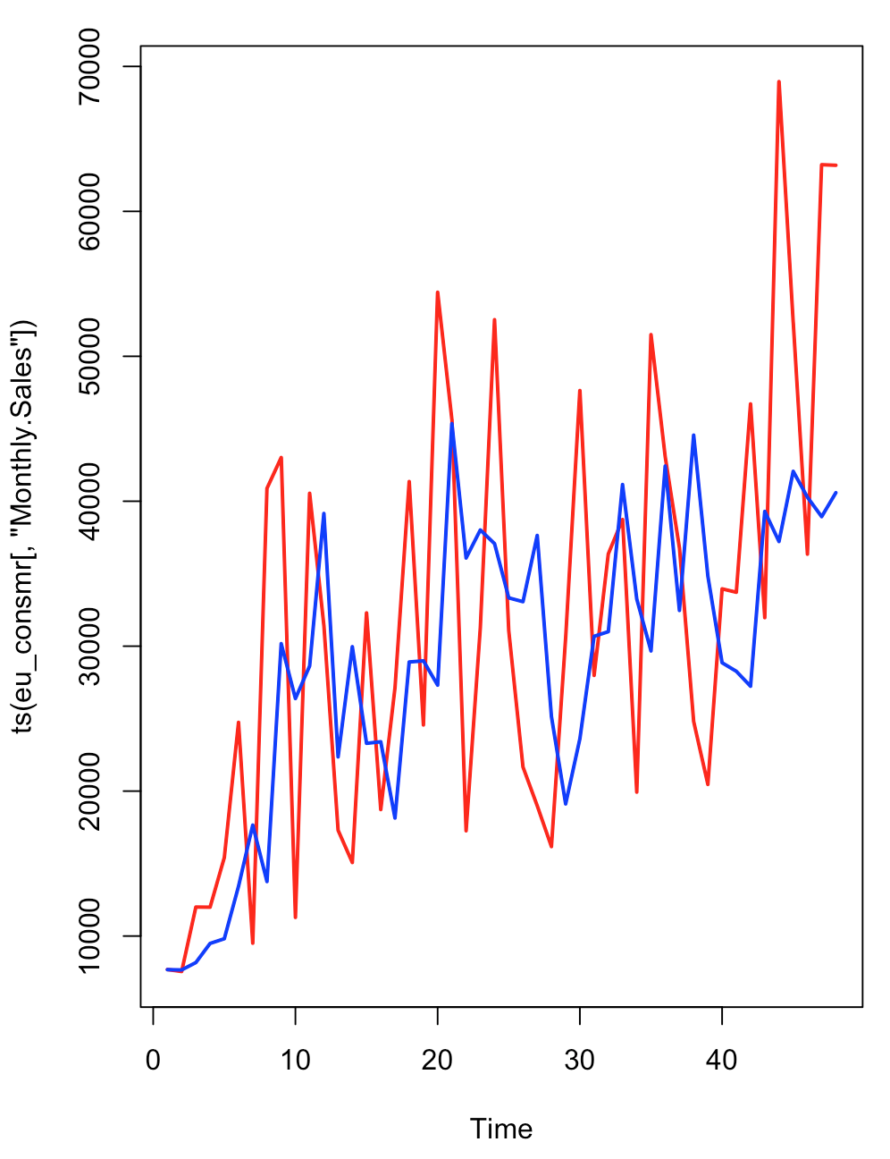
Model Building - Sales for EU-Consumer(Cont3..)
Auto Arima Method
The auto arima model was of ARIMA(2,1,0) . This implies that 1 stage differencing was performed and the resulting timeseries was modeled as AR(2).
The standard error for the AR(2) coefficient is 23.2% and 26.7% of the coefficient. This is relatively high but we will accept it with caution . sigma^2 estimated as 168564657 | log likelihood=-445.84 | AIC=897.67 | AICc=898.32 | BIC=902.81
We Obtained the following results on the Demand forecasting accuracy of Auto ARIMA model:
ME RMSE MAE MPE MAPE
Test set 12935.2 19499.13 16687.6 17.678 28.9226
Original Demand Time Series in Red and the Fitted Auto Arima Model in Blue.
Forecast - Original Demand Time Series in Red and the Fitted Auto Arima Model in Blue.

Slide 26
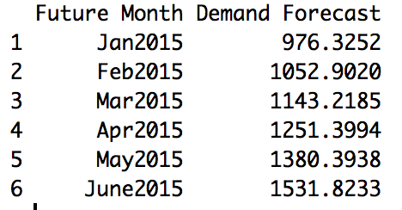
Model Evaluation/Forecasting - APAC Consumer Demand
A. Classical Decomposition Model Evaluation Result
ME RMSE MAE MPE MAPE
Test set -23.16084 127.4945 107.1754 -8.815864 18.79196
MAPE=18.79%
B. Auto ARIMA Model Evaluation Results
ME RMSE MAE MPE MAPE
Test set 12 174.3722 147.6667 -7.362467 26.24458
MAPE=26.24%
From the above results it is clear that the Classical Decomposition Model Performs better.Therefore the Classical Decomposition Model will be used to forecast the demand for the future 6 month Period.
Demand Forecast for the next 6 Months

Slide 27
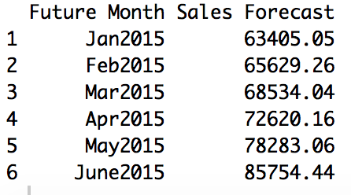
Model Evaluation/Forecasting - APAC Consumer Sales
A. Classical Decomposition Model Evaluation Result
ME RMSE MAE MPE MAPE
Test set 6515.587 14997.64 12937.14 5.024684 20.83351
MAPE=20.83%
B. Auto ARIMA Model Evaluation Results
ME RMSE MAE MPE MAPE
Test set 15848.24 22755.75 18780.19 19.73091 27.68952
MAPE=27.68%
From the above results it is clear that the Classical Decomposition Model Performs better.
Classical Decomposition Forecasting model provides a MAPE reduction of 6.86% on the Auto Arima model. Therefore the Classical Decomposition Model will be used to forecast the demand for the future 6 month Period.
Sales Forecast for the next 6 Months

Slide 28
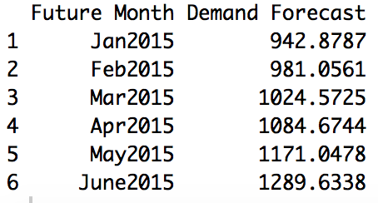
Model Evaluation/Forecasting - EU Consumer Demand
A. Classical Decomposition Model Evaluation Result
ME RMSE MAE MPE MAPE
Test set -19.25783. 189.3226 127.333. -10.38272 21.98432
MAPE=21.98%
B. Auto ARIMA Model Evaluation Results
ME RMSE MAE MPE MAPE
Test set 242.746 316.7626 253.8108 27.53891 30.13319
MAPE=30.13%
From the above results it is clear that the Classical Decomposition Model Performs better.
Classical Decomposition Forecasting model provides a MAPE reduction of 8.15% on the Auto Arima model. Therefore the Classical Decomposition Model will be used to forecast the demand for the future 6 month Period
Demand Forecast for the next 6 Months

Slide 29
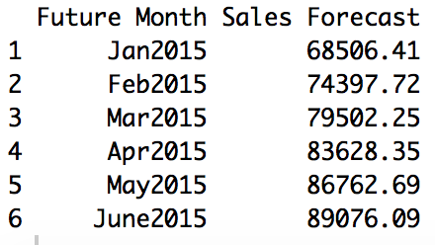
Model Evaluation/Forecasting - EU Consumer Sales
A. Classical Decomposition Model Evaluation Result
ME RMSE MAE MPE MAPE
Test set 4172.431 13736.59 10622.04 2.259534 20.73958
MAPE=20.73%
B. Auto ARIMA Model Evaluation Results
ME RMSE MAE MPE MAPE
Test set 12935.2 19499.13 16687.6 17.678 28.9226
MAPE=28.92%
From the above results it is clear that the Classical Decomposition Model Performs better.
Classical Decomposition Forecasting model provides a MAPE reduction of 8.19% on the Auto Arima model.Therefore the Classical Decomposition Model will be used to forecast the demand for the future 6 month Period.
Sales Forecast for the next 6 Months

